Slide 1
From Voxels to 3D
Uri Mike

Slide 2
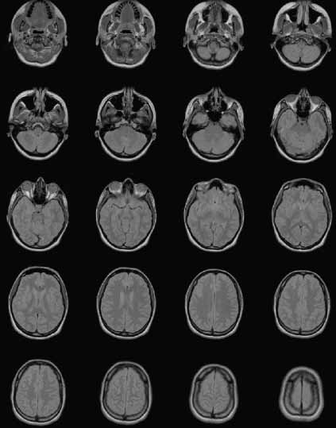
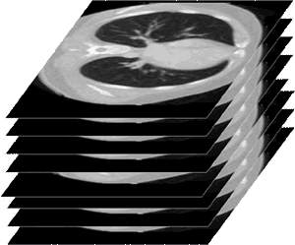
Motivation
All around visualization of scanned data for medical applications (DICOM). Allows easier analysis and pathology detection.
3D Printing process validation
More...

Slide 3
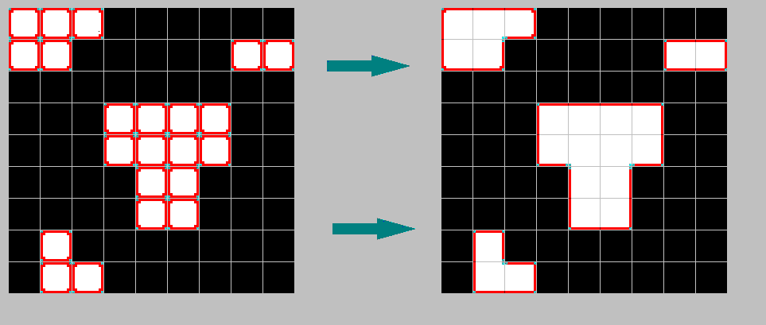
2D Version
Given binary image : 1-bit depth array of pixels
Find all edges that participate in the polygon
HOW ?

Slide 4
2D Version
Iterate all pixels in a consistent horizontal and vertical direction (e.g. right then bottom)
For a tested pixel, put an edge to the left/top if needed.
Pad with 0’s

Slide 5
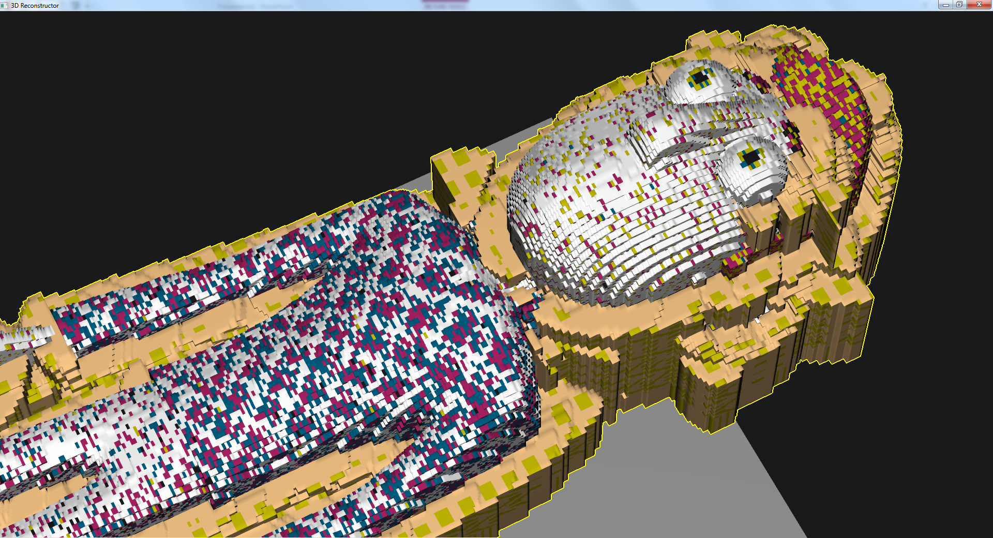
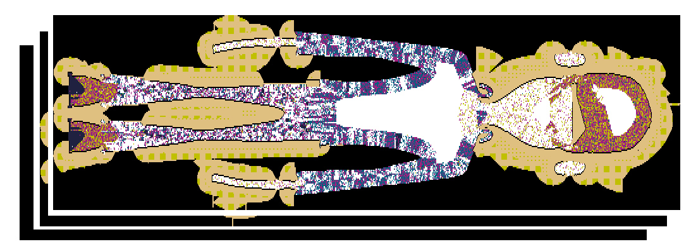
Up to 3 Dimensions
Given voxel data (typically set of slices)
Create a mesh
HOW ?

Slide 6
Up to 3 Dimensions
Serial scan in 3 dimensions
Build “wall”/”floor” composed of 2 triangles each
Consider color
Only create geometry for the external surface (typically opaque)
Complexity O(n) n = number of voxels

Slide 7
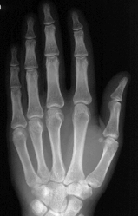
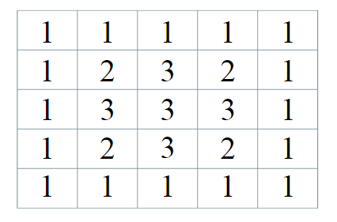
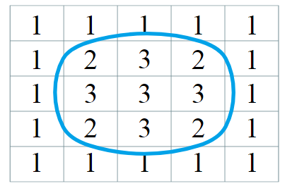
Back to 2D : Marching Squares
Given an image (= 2D scalar field array) and a threshold
We want to get a nice polygonal representation
Threshold=1.5

Slide 8
Back to 2D : Marching Squares

Slide 9
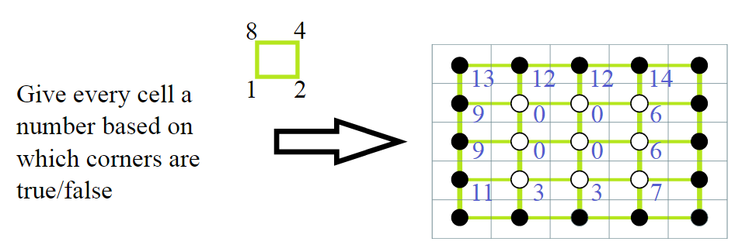
Back to 2D : Marching Squares

Slide 10
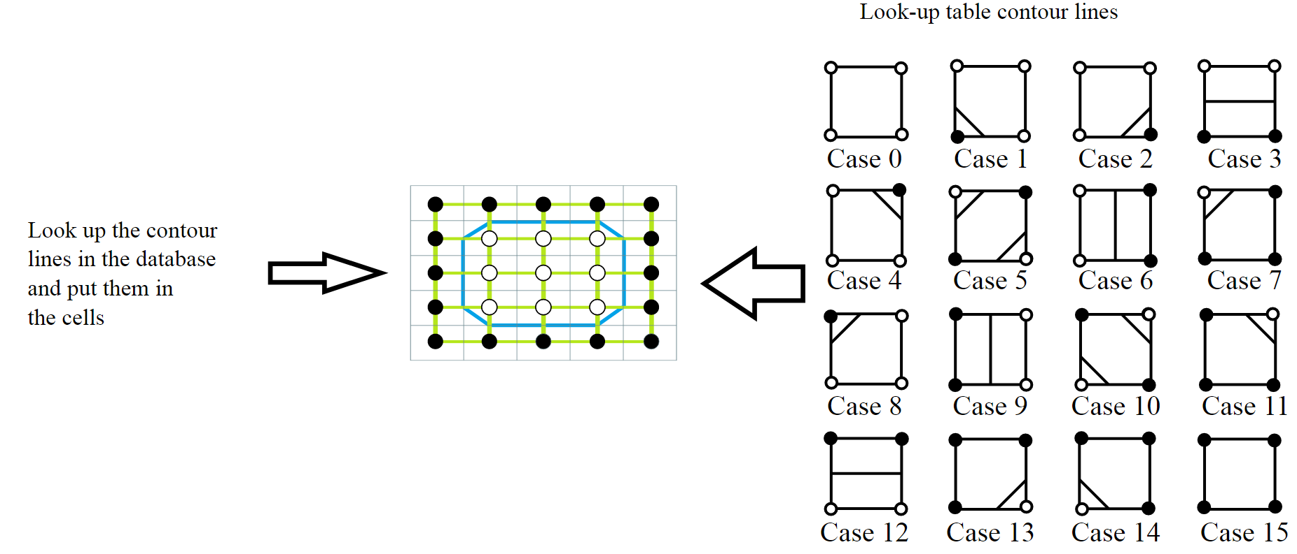
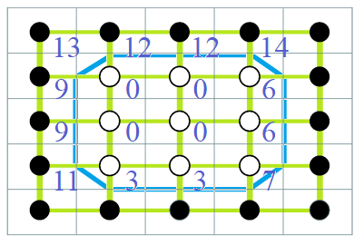
Back to 2D : Marching Squares

Slide 11
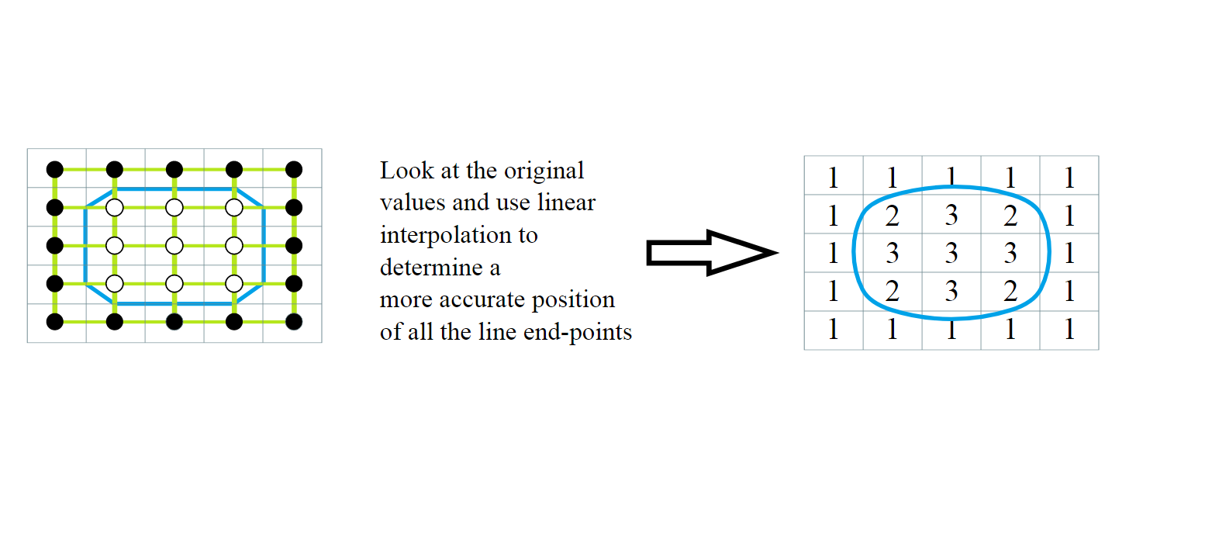
Back to 2D : Marching Squares
Position end-point according to threshold value
Nice Example: http://jamie-wong.com/2014/08/19/metaballs-and-marching-squares/

Slide 12
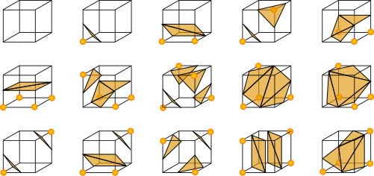
3D: Marching Cubes
Analogous to Marching Squares
Published in 1987, one of the most cited papers in CG
Works on 8-voxel neighborhoods (to form a cube)
Dictionary of 256 possible combinations
Similarly, each vertex of the generated polygons is placed on the appropriate position along the cube's edge by linearly interpolating the two scalar values that are connected by that edge.

Slide 13
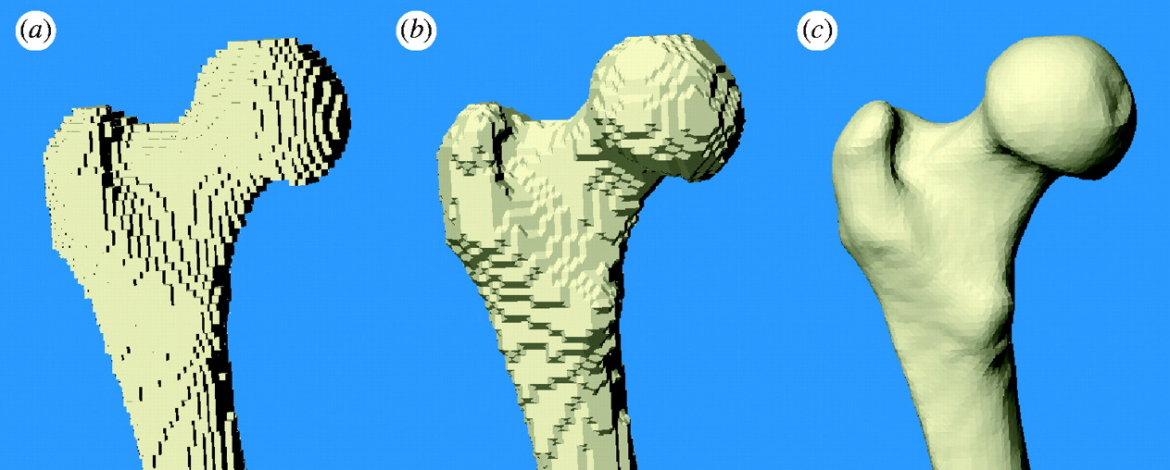
3D: Marching Cubes
Voxels
Marching Cubes, no interpolation
Marching Cubes, with interpolation

Slide 14
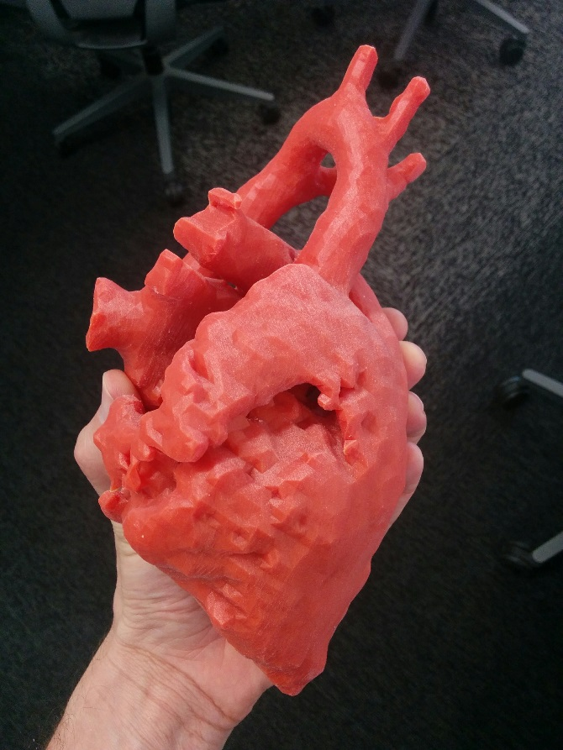
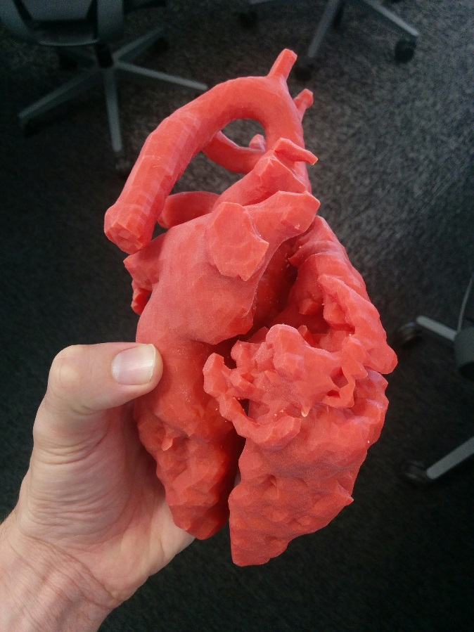
3D Marching Cubes
Printed example:

Slide 15
References
Marching Cubes original paper (1987): http://ab.cba.mit.edu/classes/S62.12/docs/Lorensen_marching_cubes.pdf
Example for Marching Squares: http://jamie-wong.com/2014/08/19/metaballs-and-marching-squares/

