Slide 1
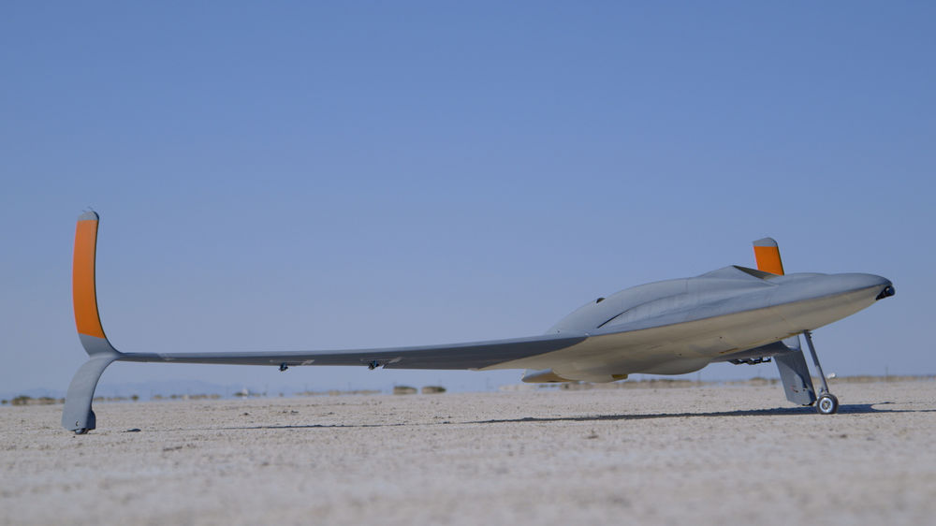
Applications of Additive Manufacturing in Aerospace engineering

Slide 2
Definitions
Structure: Broadly defined, an arrangement and organization of interrelated elements in a material object or system
In Engineering, structural mechanics is the study of the mechanical behavior of solids and structures. Intuitively, a structures purpose is to resist forces.
Aerospace structures differ from other structures due to their high demands for performance and lightweight

Slide 3
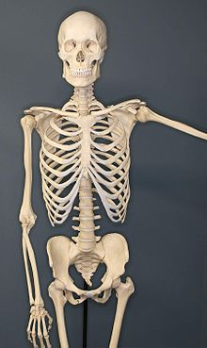
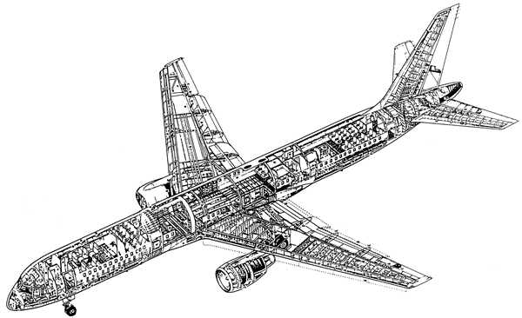
Examples of structures

Slide 4
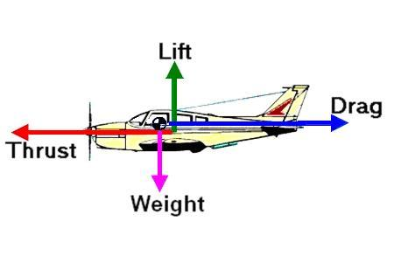
Airplane - Force Diagram
$$∝V^{2}$$
$$∝V^{2}$$

Slide 5
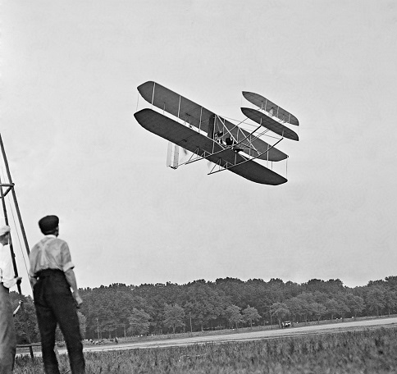
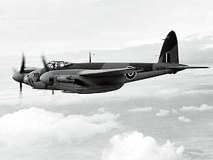
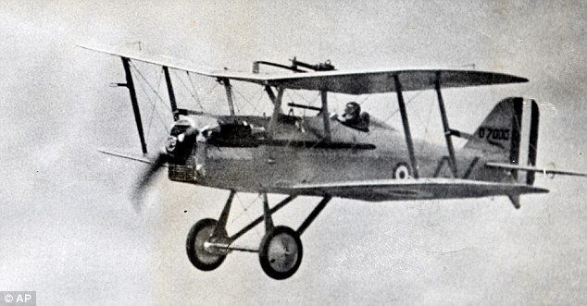
Structural Materials - Survey
First planes – wood (spruce) truss and fabric
Only engine mounts made of metal
Fabric used for wing surfaces only, no structural significance
Use of wood up until WW2 – DH. 98 (Mosquito - “wooden wonder”)
Notes:
DH. 98 special – wooden with monocoque structure

Slide 6
Survey - Continued
End of WW2 – shift to metals (aluminum) and moncoque structure
Isotropic properties and durability of metals make manufacturing and assembly easier
Monocoque – no external load carrying frame
Both tensile and compressive stresses are carried by skin.
Specialized structural parts, each bearing a specific part of the load
Ribs
Spars
Stringers
Bulkheads\Formers
Skin

Slide 7
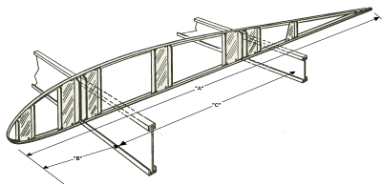
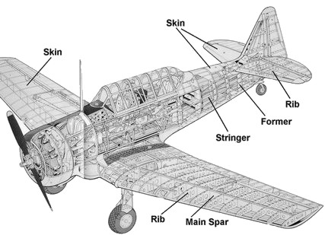
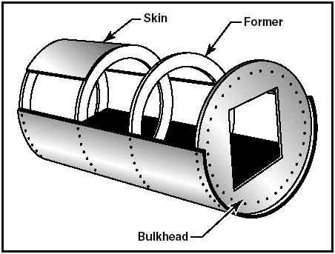
Monocoque Structure
spar
rib

Slide 8
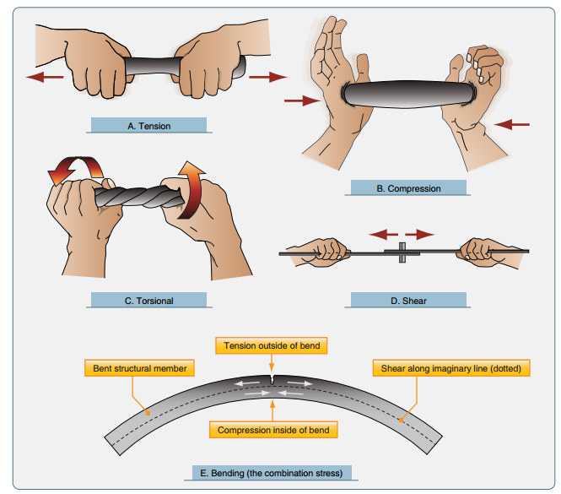
Types of Loads Acting on Aircraft
Stringers- tension\compression
Skin – shear
Former – torsion\bending
Rib – bending
Spar (a.k.a torque box)– torsion
Notes:
Problem – all these parts are made from aluminum – same strength in all directions – waste!

Slide 9
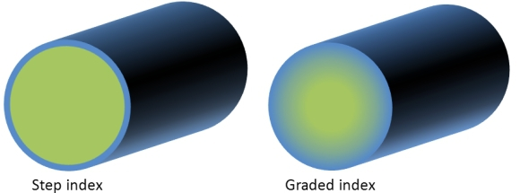
Survey - new materials
Composite materials
Made from combination of high tensile strength fiber embedded in a matrix (glue)
Properties of laminate can be engineered using lamina lay up pattern.
Functionally graded materials
Materials with continuously varying properties (magnetic, mechanical, thermal)
Have many applications in spacecraft and launch vehicle design
Still underdeveloped for widespread commercial use.
Gradient nature of material suitable for additive manufacturing
Notes:
Composites will be further explained in the context of 3d printing later

Slide 10
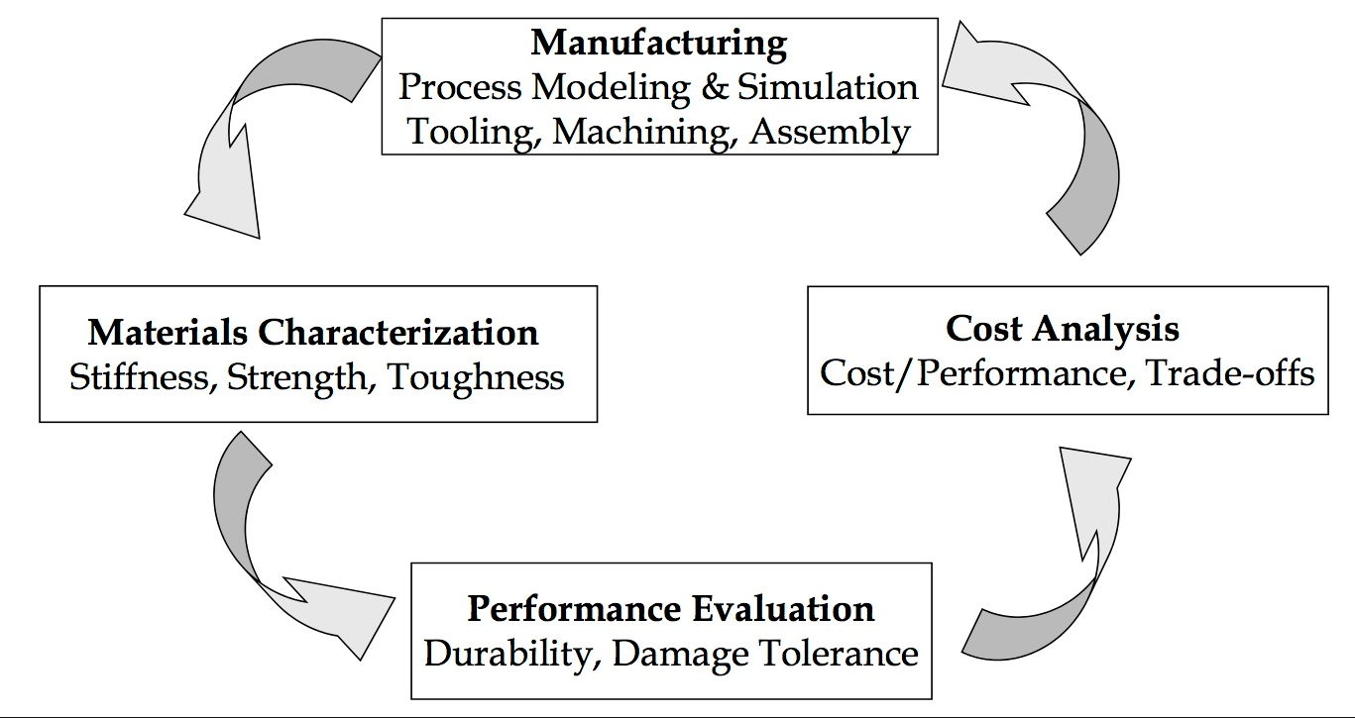
Design Process
Notes:
Traditional Design Process - additive manufacturing has an impact on every stage

Slide 11
Design Process
A Single iteration consists of choosing candidate materials and geometry of the part and solving a “sizing” problem:
Input: acting forces and boundary conditions
Objective functions to minimize: Weight
Constraints
Acting stresses must not exceed rated failure stresses of material (both static and dynamic stresses)
Acceptable deformation (within elastic region)
Acceptable manufacturing and assembly costs
Notes:
Cost includes many things, but in aerospace a lot of the time…

Slide 12
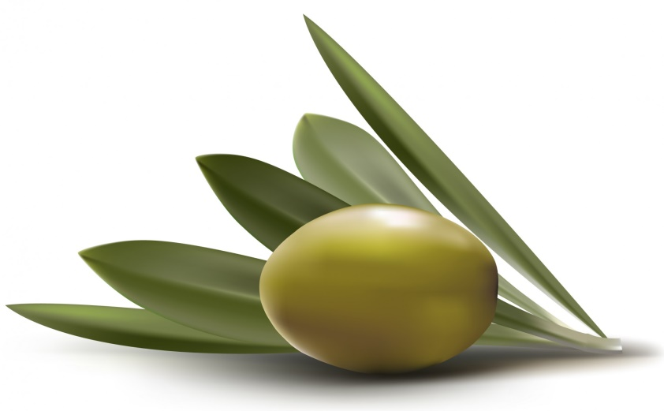
Optimizing Weight = Optimizing Cost
In 1987, Bob Crandell, CEO of American Airlines saved $40,000 (conservative estimate) by removing one olive from every salad served in-flight
Recently, Ryanair cuts amount of ice taken on flight, changes magazine from A5 to A4 paper.
Reducing Weight also important from environmental concerns – less fuel burned

Slide 13
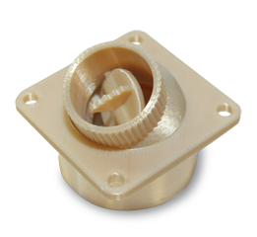
3D printing production parts
Not only for prototyping – actual, useable parts for final assembly
IAF uses ultem 9085 with stratasys fortus
Ultem 9085 is an FAA approved material
Burning ultem 9085
Burning ABS
Notes:
Pass around ultem parts

Slide 15
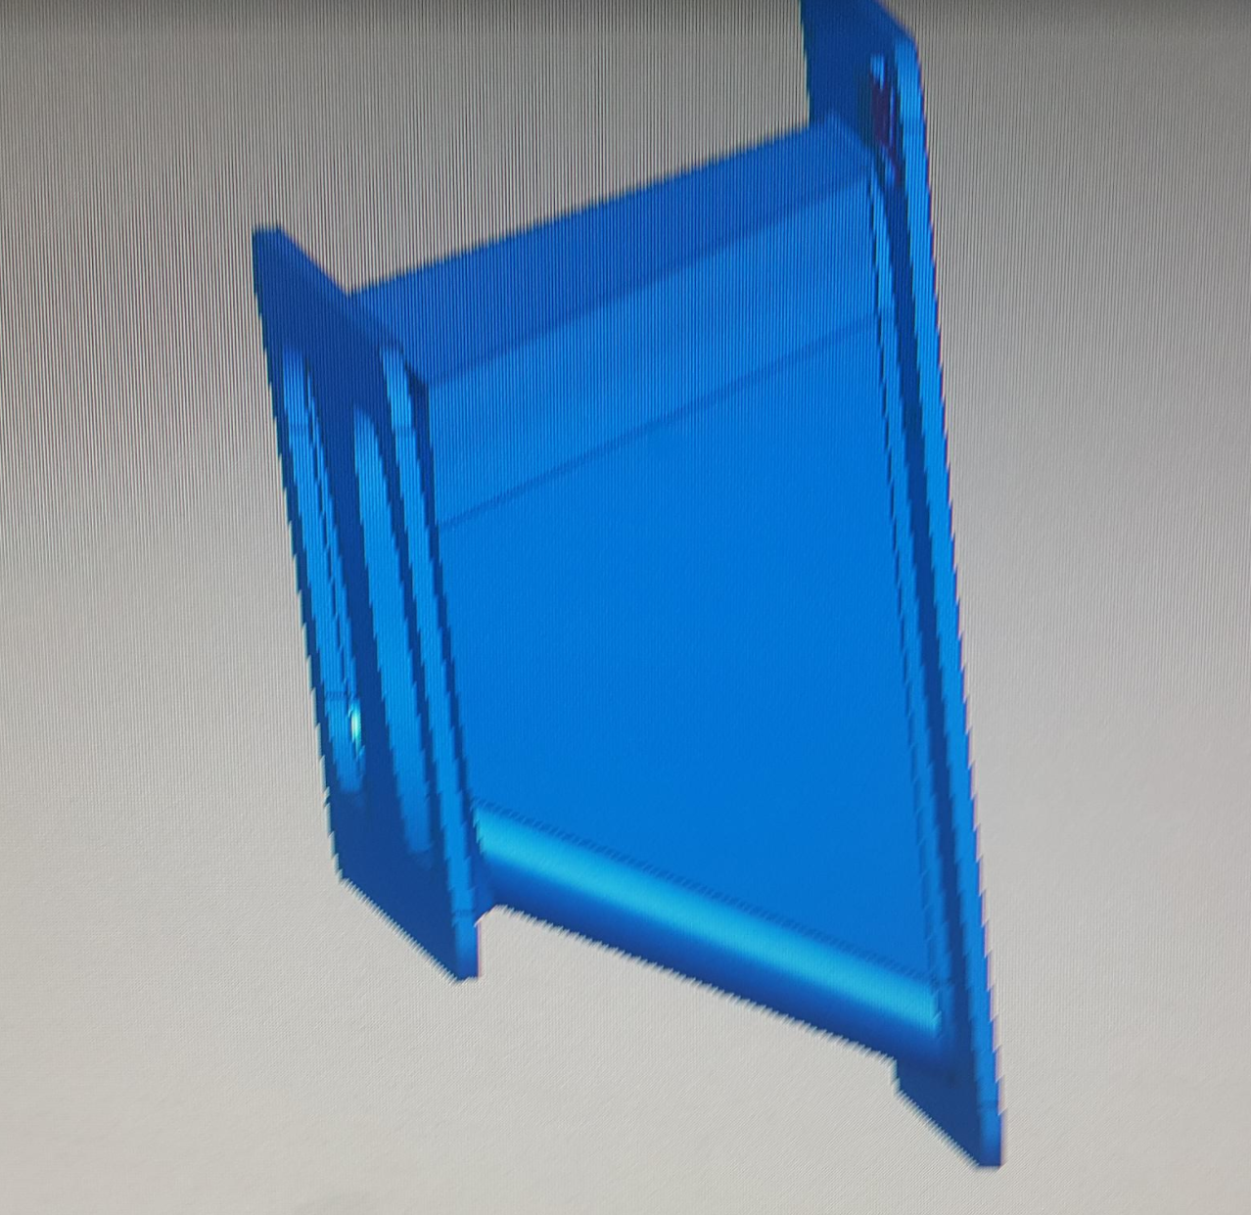
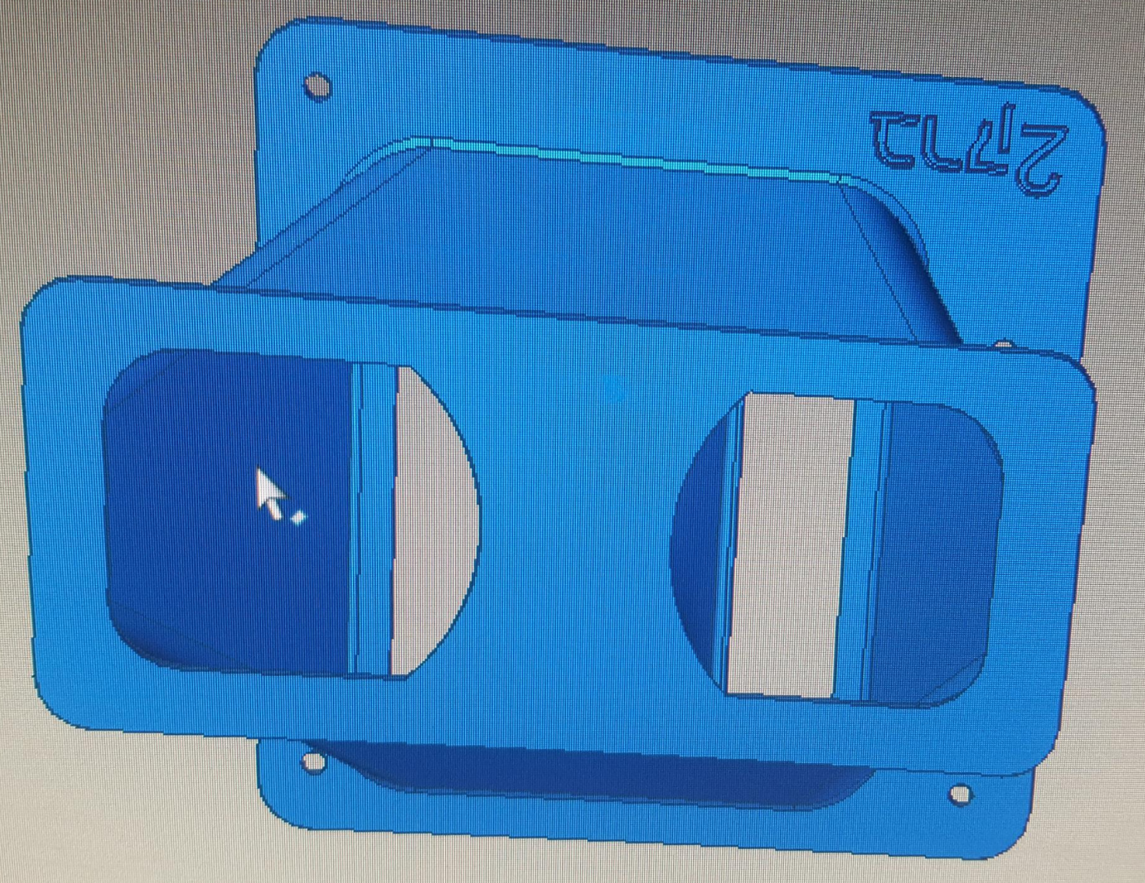
Design Process
Additive Manufacturing (from plastics or metals) allows complex geometries which lower part counts and consequently the cost and final weight of part
Very hard to achieve with CNC
Manufacturing by mold is impractical due to low volume

Slide 16
Tooling
Ultem’s reltaive durability allows it to be used for creating tooling
Large waist of metal is spared
What’s a joggle?

Slide 17
Case Study: 3D printed jet aircraft from ultem 9085
80% printed parts
First printed jet powered aircraft

Slide 18
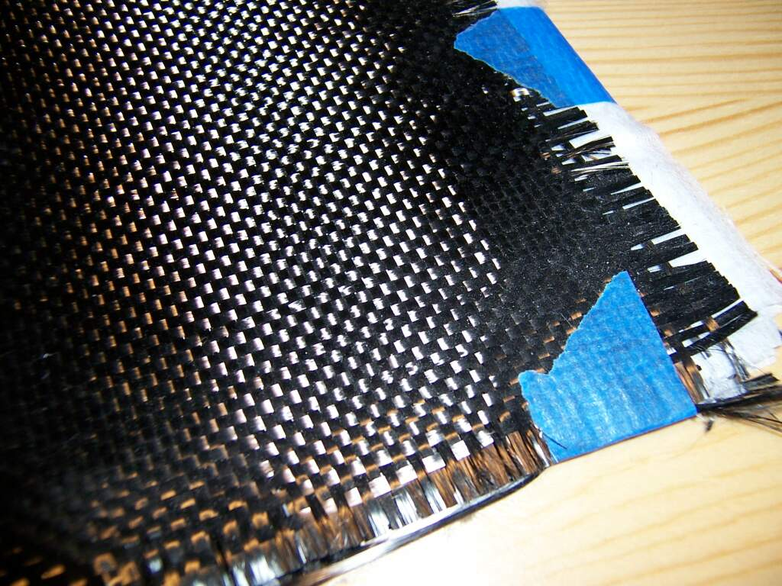
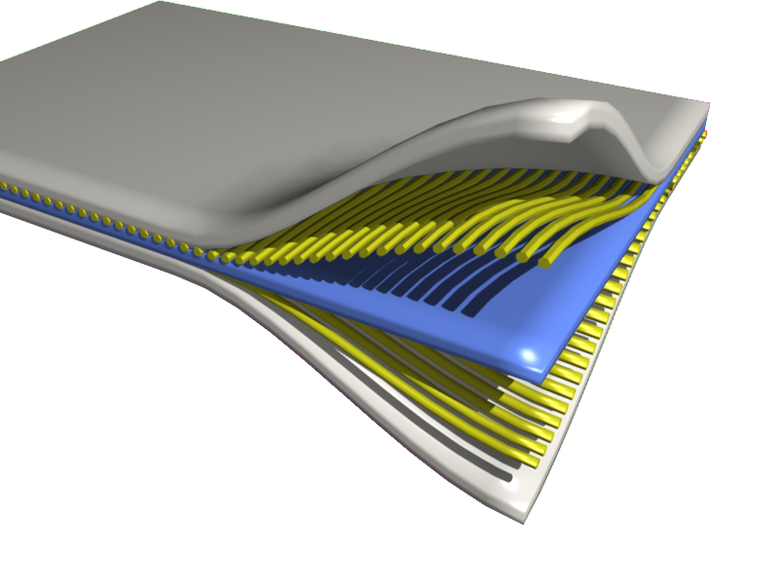
Composite materials
Composite materials allow maximizing design effectiveness using directional mechanical properties (anisotropic) – minimize wasted material providing uneeded strength to structure.
Resin (matrix) layer
Fiber layer

Slide 19
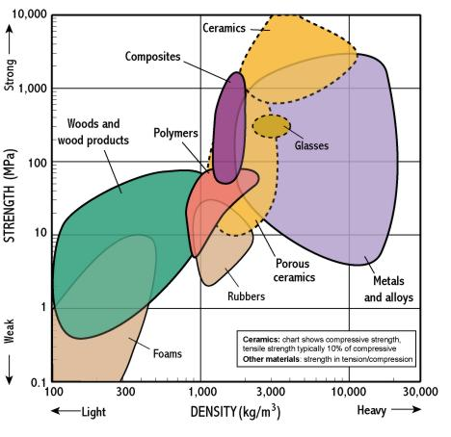
Composites vs. Metals – Specific Strength
Notes:
Note that metals and composites relatively matched in strength, but composites have clear advantage in weight

Slide 20
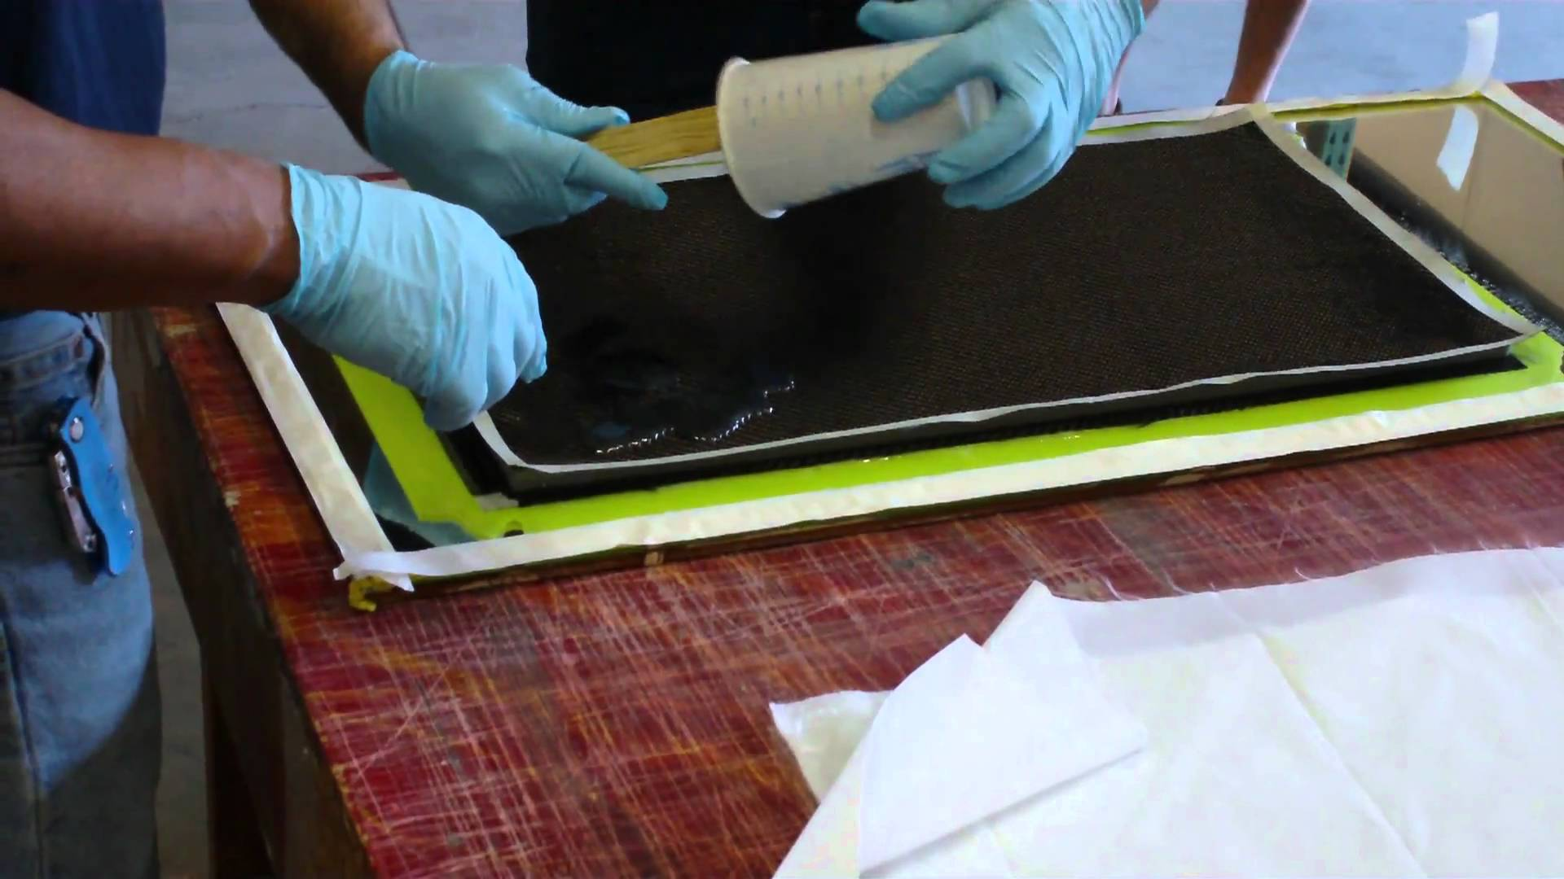
Composite Materials - Continued
Big disadvantage – quality is strongly dependent on skill of fabricator.
New technologies allow for printing composites – mechanizing the process allows more consistent quality and lowers cost of skilled labor required

Slide 21
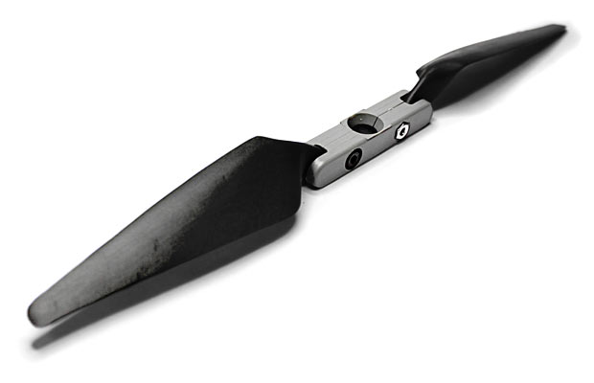
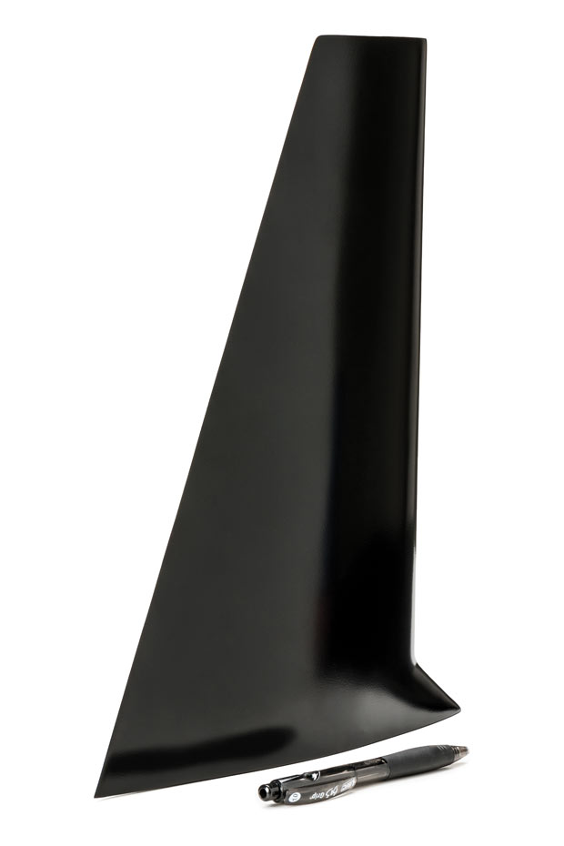
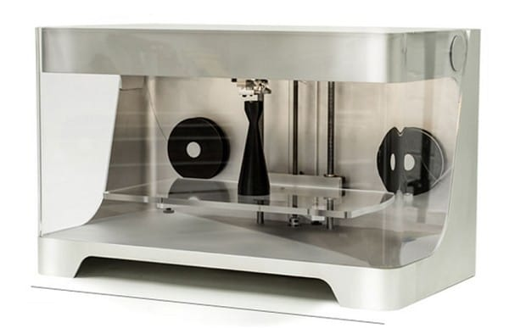
3D printing composites
example
slicer

Slide 22
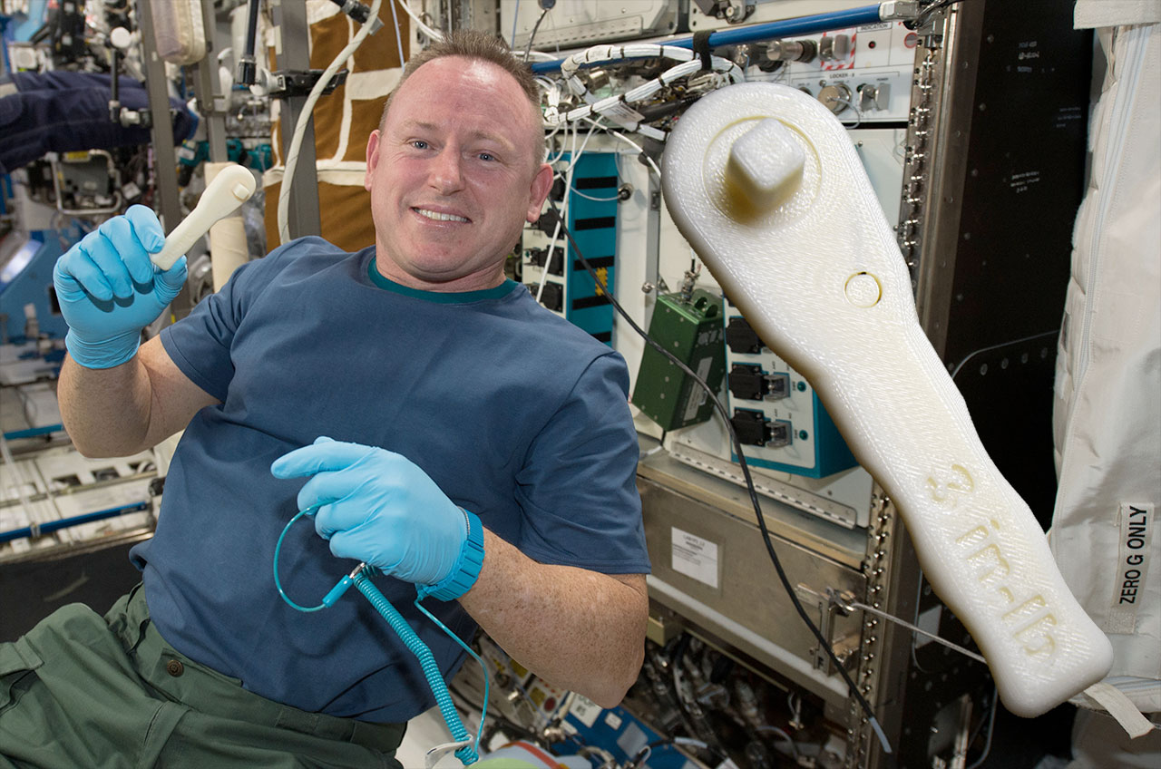
Space applications

Slide 23
Space applications
In space –keeping low weight is even more crucial
To minimize excess payload, print equipment\tools in space rather than carrying it at launching
Using unique properties of 3d printing tools with moving parts can be created in a single 3d print – no assembly required
Meta-materials
Printing a wrench
Notes:
It can take months or even years, depending on the launch resupply schedule, to get equipment to space, and for exploration missions, resupply from Earth may be impossible. This technology may change how NASA completes exploration missions and even the way science is conducted on the station.
The team at the Hasso Plattner Institute's Human Computer Interaction Lab design objects that move despite being 3D printed as one single part.

Slide 24
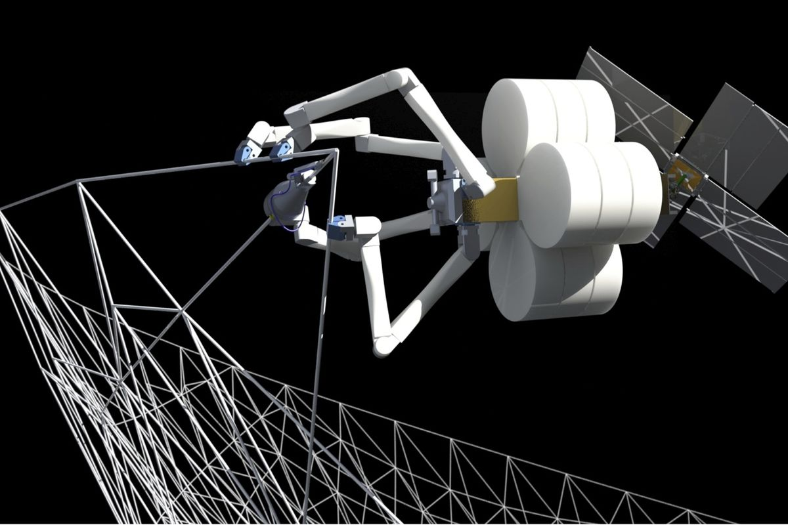
Ambitious Additive Manufacturing Projects in Space
Launched 2012, NASA funded SpiderFab, developed by Tethers Unlimited, aims to manufacture spacecraft parts in space
Company aims for in-space demo in early 2020’s
Manufacturing and Assembly is done by spider-like robots in orbit
Notes:
FOOTBALL FIELD-SIZED ANTENNAS BUILT DIRECTLY IN SPACE

Slide 25
Summary
Minimizing Weight = Minimizing Cost
Pressures in aerospace to cut cost of design by tailoring material properties and geometry to achieve goal with minimal cost.
Currently in the aerospace industry, 3D printing is used to supplement traditional production methods, or as prototyping aid, but this is changing as technology matures
exciting and unique applications in space missions

