Slide 1
Autonomous Drones Lab Autonomous Navigation Using Apriltags
Robot Motion Planning Workshop 10.03.2020

Slide 2
What Do We Play With in the Drones Lab…?

Slide 3
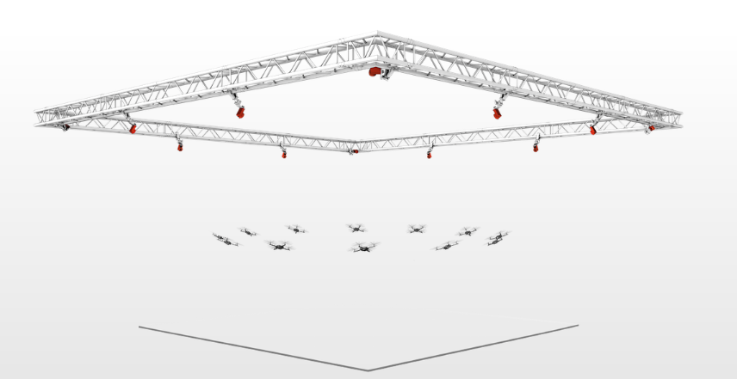
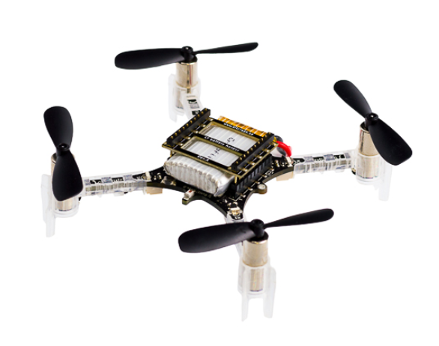
Last Year’s Project – Crazy Game

Slide 4
Last Year’s Project – Crazy Game (cont)

Slide 5
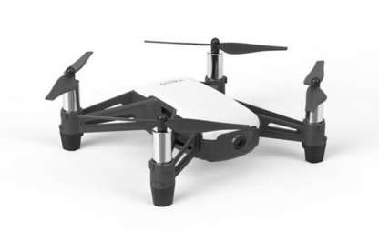
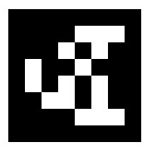
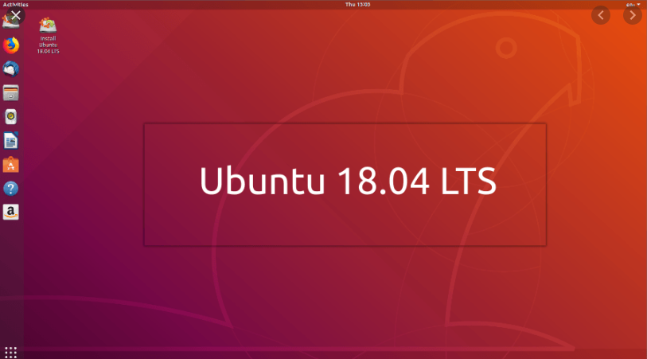
Platforms Used in this Year’s Project
Apriltag
ROS (Robotics Operating System)
DJI Tello
Ubuntu 18.04

Slide 6
Apriltag: vision-based marker for pose estimation

Slide 7
Goal - Autonomous Navigation using Apriltags
Steps:
Learn a short course on ROS with Python
Get acquainted with the GUI developed for the Tello
Use the Apriltag for hovering at one place
Follow a simple path combined of 4 Apriltags
Autonomous Navigation in the Computer Science building using Apriltags spread around the building

Slide 8
References
https://github.com/AprilRobotics/apriltag
https://github.com/AprilRobotics/apriltag/wiki/AprilTag-User-Guide
https://www.robotigniteacademy.com/en/course/ros-in-5-days/details/
http://wiki.ros.org/apriltag_ros
https://github.com/tau-adl/Tello_ROS_ORBSLAM
https://pypi.org/project/apriltag/
https://april.eecs.umich.edu/software/apriltag
https://roboticsknowledgebase.com/wiki/sensing/apriltags/
https://www.coursera.org/lecture/robotics-capstone/b3-5-introduction-to-apriltags-Jqmuq

Slide 9
THANKS!
Any questions?
Yoni
Yehon2@mail.tau.ac.il

