Slide 1
Friendly introduction to Robotic Estimations
Dor Israeli
Robotic Motion Planning course, 2019
Some sketches from the great Kalman and Bayesian Filters in Python by Roger R. Labbe

Slide 2
OR
Realistic Motion Planning

Slide 3
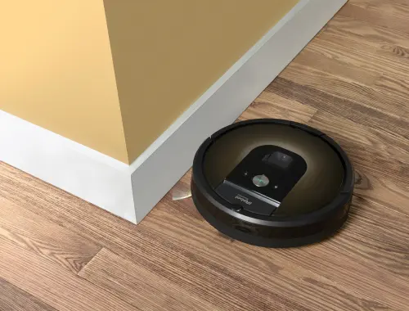
Lacking initial knowledge
Image by
http://lazygamer.co/

Slide 4
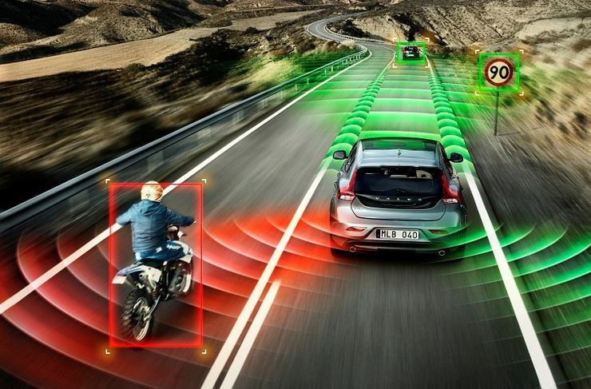
Systems are usually dynamic
Image by
geoawesomeness.com/

Slide 5
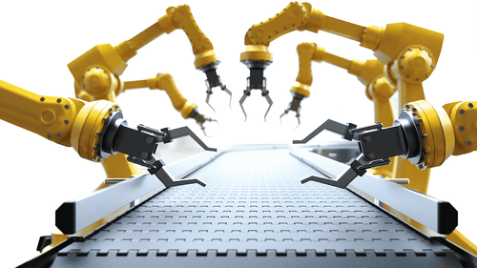
Imperfect execution
Image by
www.indiamart.com/

Slide 6
Estimations in Robotic Motion Planning
Understand environment(obstacles, radiation, temp., …)
Understand self (position, velocity, battery, …)
Stop if done
Solve robotic plan (constraints, optimization, …)
Execute next step
Goto 1

Slide 7
Agenda
Tracking a Dynamical system
Naive approaches
1
The Kalman Filter
2
Nonlinear Filters
3
4

Slide 8
Tracking a Dynamical system

Slide 9
What is a Static System?
Noisy measurements are given offline
Measurements describe the same situation (different readers, POVs, ...)
Usually solved using least mean squares
For example:
Measuring your height, by measuring several times and averaging
Calculating linear trend of points on a graph
Trying to locate yourself using triangulation (by a river, 1 km near the building)

Slide 10
What is a Dynamical System?
Noisy measurements are given online
The state evolves with time (e.g. physical motion)
There is a connection (known or not) between states
Our understanding may change according to new findings
Goal is usually to accurately track some changing quality and predict its future state
For example:
A/C tracking and affecting room temperature
Autonomous car navigating using GPS+Accelerometer
Tracking a bird using reverse-GPS

Slide 11
So, why is it hard?
No theory
Inaccurate theory
Complex theory
Noisy measurements
Real-time
Spontaneous disturbances
...

Slide 12
Simple example: Quadcopter with constant power
A quadcopter was at some known previous height and it’s engine is at constant output:
Our noisy instrument measures the copter’s height every fixed interval
We’d like to track and predict the copter’s height as accurately as possible in real-time

Slide 13
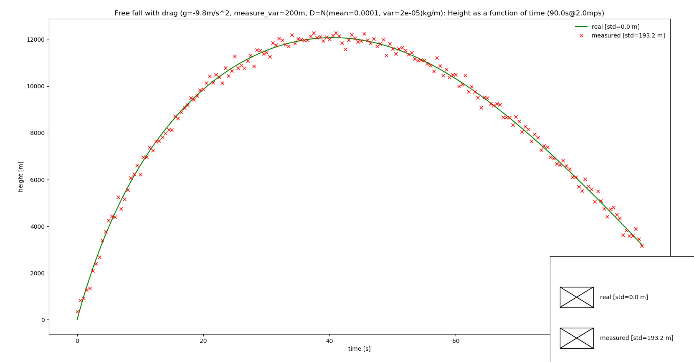

Slide 14
Can’t I just use the measurements?
Pros:
Doesn’t require dynamics theory
Doesn’t require resources (time, cpu, etc)
Doesn’t diverge
Standard deviation is known
Cons:
Does not leverages known theory
Instrument’s standard deviation might be too big
Results are usually not smooth
Results are sometimes not sensible
Sometimes the instruments misses a measure
...

Slide 15
Naive approaches

Slide 16
Moving Average Algorithm
As a prediction, output the weighted mean of the last N measurements
Assumptions:
Measurements in close range describe the similar states
If given several measurements of the same state, it’s safest to assume the (weighted) mean
Pros:
Applicable when no specific dynamic is known
Gets better upon increasing resolution
Cons:
Can’t use known theory
Usually lags
Will err and not converge if the function changes too quickly
Can’t combine with different types of measurements or knowledge

Slide 17
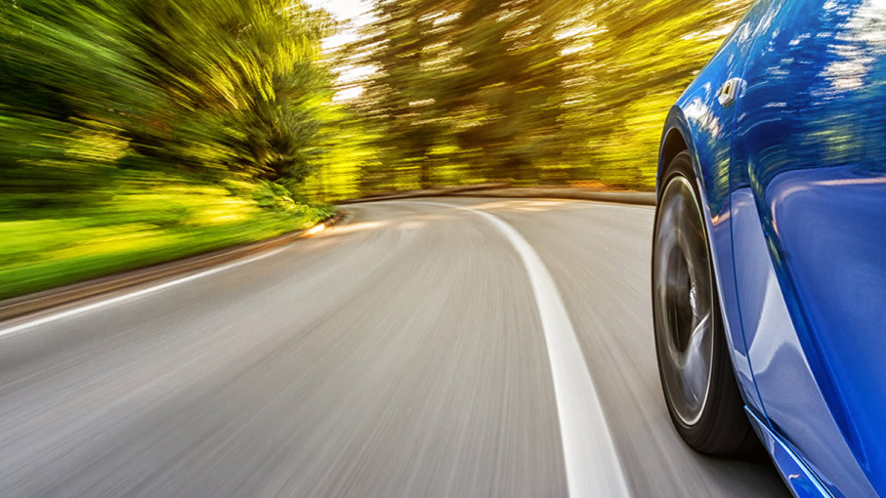
Bad robotic use case- fast changing world
Image by
auto.howstuffworks.com/

Slide 18
Online Least Mean Squares Algorithm
Each time step, look at the problem as a static system
Trying to fit given measurements into some assumed linear theory, e.g:

Slide 19
Online Least Mean Squares continued
Pros:
Makes use of some theory
outputs sensible results and latent variables
Cons:
requires a linear theory to fit into
Usually can’t use previous calculations
Might diverge on noisy measurements or inexact theory
Might be inexact and expensive in nonlinear cases

Slide 20
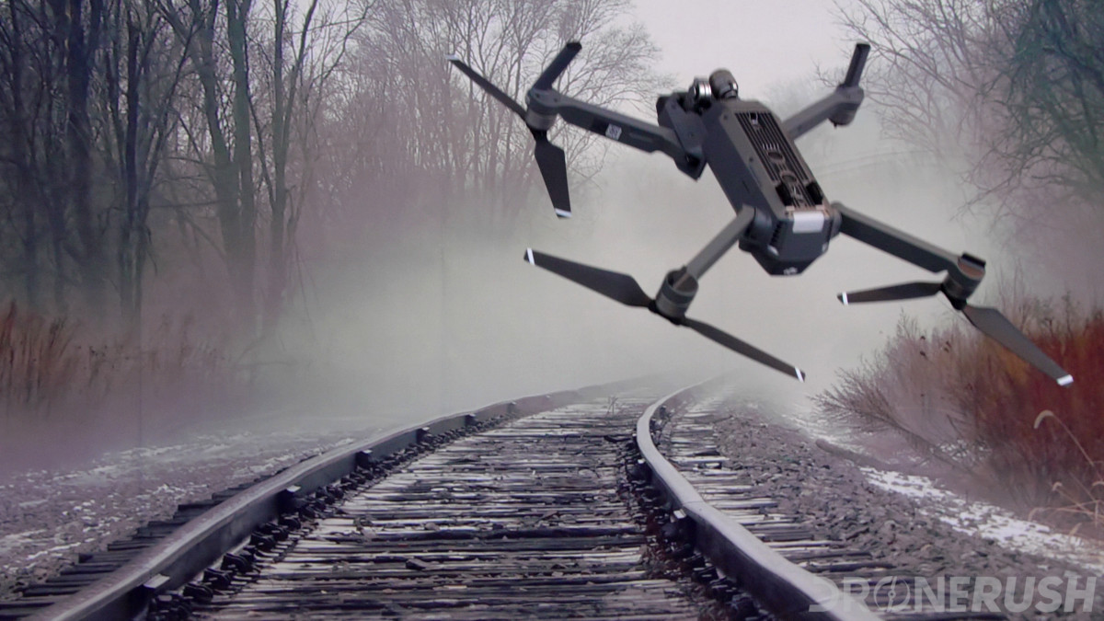
Bad robotic use case- time critical situations
Image by
dronerush.com/

Slide 21
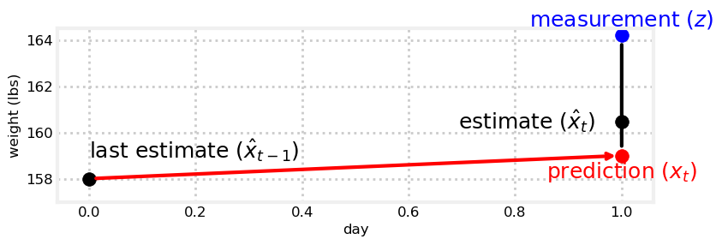
𝛂-𝛃 Filters
Many systems can be approximated to have a constant rate of change
Higher dimensions variations exist, but usually irrelevant because interactions are too complex
Lower dimension is the moving average algorithm!
Predict: extrapolate our previous calculated state using calculated rate of change
Update: Find weighted mean with current given measurement (using the 𝛂-𝛃 ratios)

Slide 22
𝛂-𝛃 Filters continued
Pros:
Makes more balanced use of both theory and measurements
Handles noise or inaccurate theory better
Doesn’t require resolving entire system
May combine different types of measurements
Cons:
Ratios are set manually by trial and error
Requires some theory
Might not converge to correct result
Hard-coded ratios handles changing dynamics poorly
Effectively supports just two dimensions (position, velocity)

Slide 23
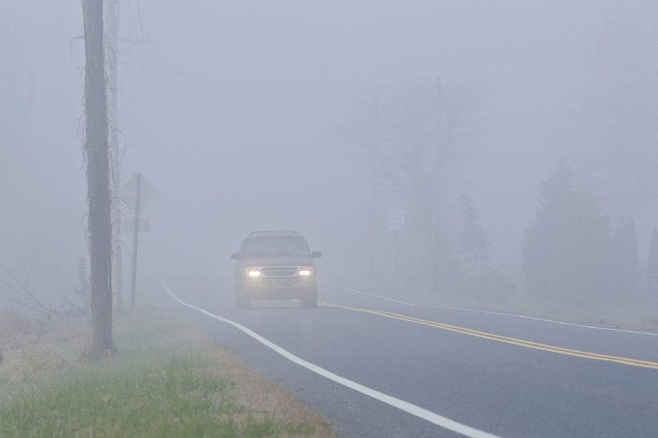
Bad robotic use case- Changing Environment
Image by
www.forbes.com/

Slide 24
The Kalman Filter

Slide 25
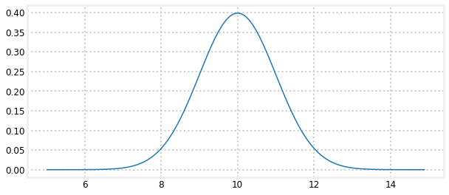
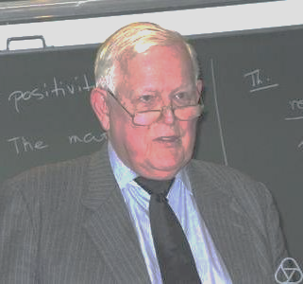
Kalman Filter as a Bayesian 𝛂-𝛃 Filter
The 𝛂-𝛃 Filter is a good start, but dynamic 𝛂-𝛃 ratios are a better idea:
Spares us the research needed for each new system configuration
Finds more accurate ratios
Ratios could change over evolution
Represent our belief as a probability gaussian:
thesis as mean and confidence as variance
The more confident a belief is, the more influential photos provided by Greuel, Gert-Martin
Can converge to the ideal 𝛂-𝛃 Filter

Slide 26
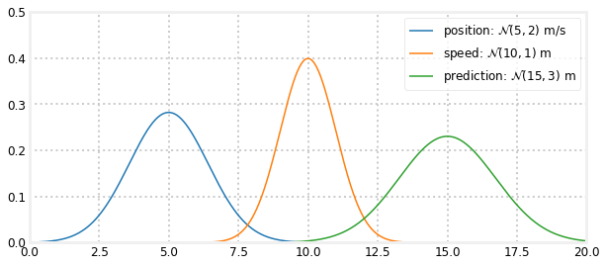
Intuition in 1D: prediction step
Prior state x_{i-1}~N(μ_{x|i-1}, σ_{x|i-1}²)
After a time interval (𝚫t) at some speed with some confidence, v_{i-1}~N(μ_{v|i-1}, σ_{v|i-1}²)

Slide 27
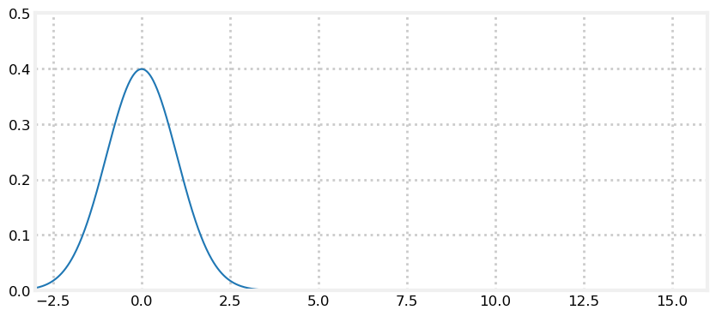
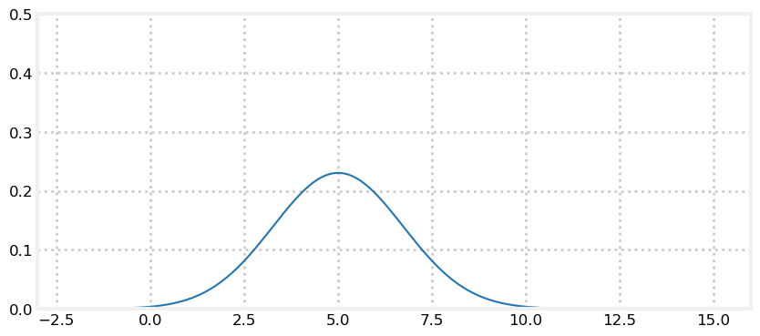
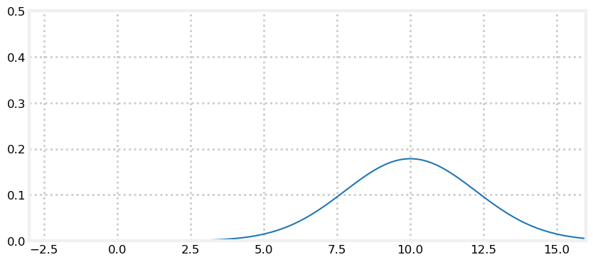
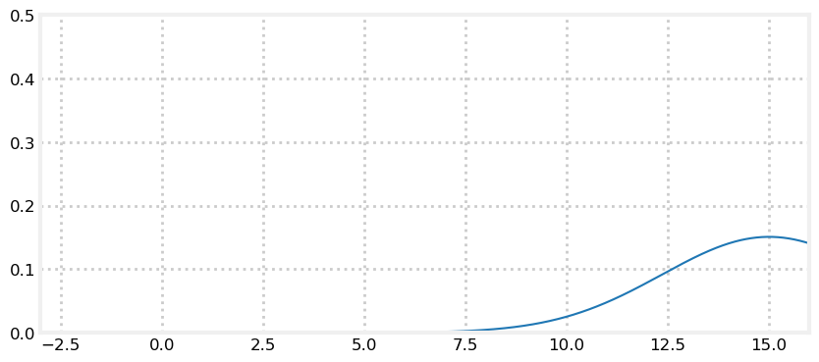
Moving with uncertainty

Slide 28
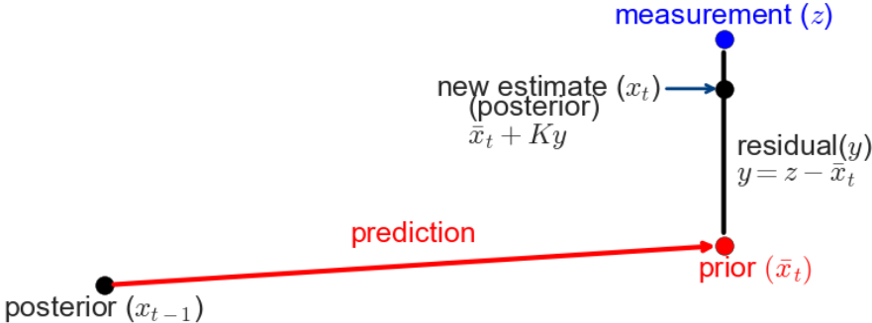
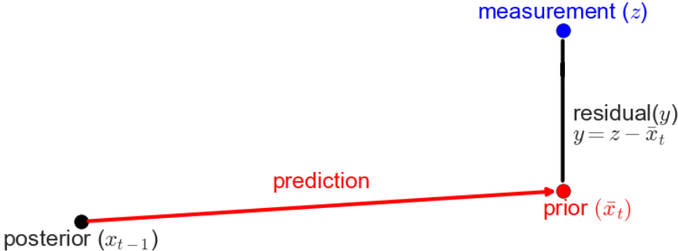
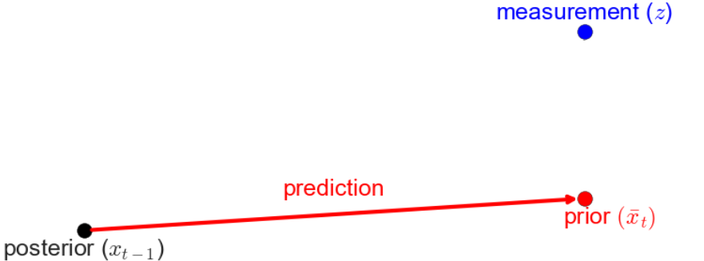
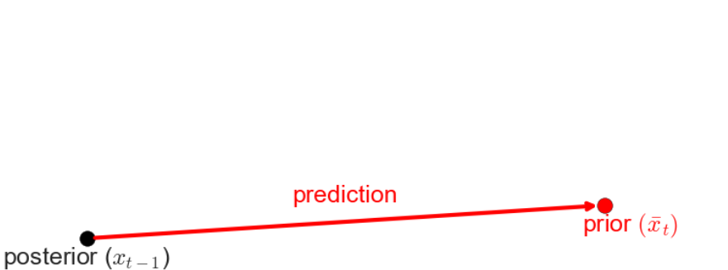
Algorithm steps: predict & update

Slide 29
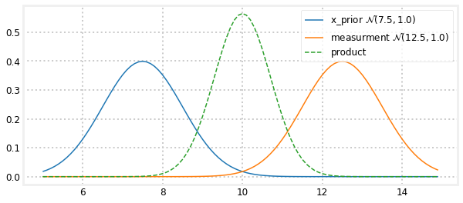
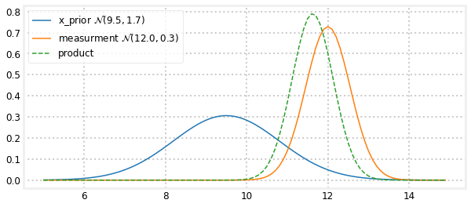
Intuition in 1D: update step
Upon receiving new measurement m~N(μ_{m}, σ_{m}²)

Slide 30
Kalman Gain
We define the Kalman Gain as K_{i}=σ_{prior|i}²/(σ_{prior|i}²+σ_{m|i}²), and r_{i}=μ_{m|i}-μ_{prior|i}
μ_{posterior|i} = μ_{prior|i}+K_{i}⋅r_{i}
σ_{posterior|i}²= σ_{prior|i}⋅(1-K_{i})
K_{i} is the dynamically calculated 𝛂 ratio!

Slide 31
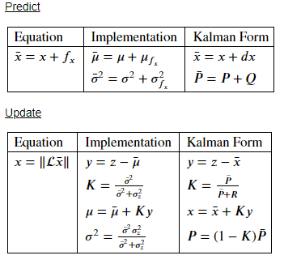
Formalization: Univariate Kalman Filter
Looking at the 1D problem (Gaussians) gave us intuition, but the true power lies in higher dimensions
In order to support higher dimensions we first need to formalize in scalar Kalman form:

Slide 32
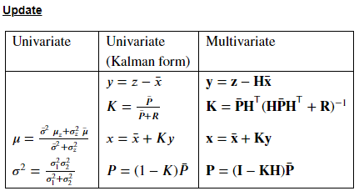
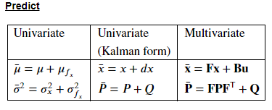
Formalization: Multivariate Kalman Filter
We want to support more variables
Multiple observed states (e.g: x sensor and v_{y} sensor)
Multiple unobserved states (e.g: clock offset)
Maybe some are in our control
Cross correlation

Slide 33
Practical Example

Slide 34
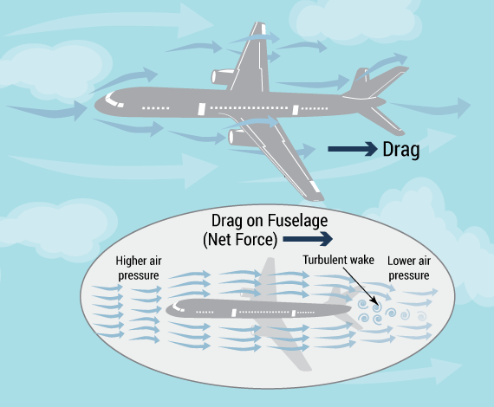
Bad robotic use case- nonlinear model
Image by
https://imgur.com/user/gabiekur

Slide 35
Nonlinear Filters

Slide 36
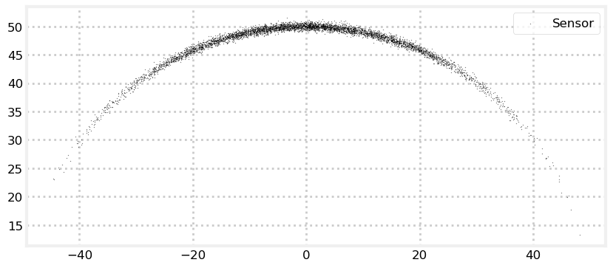
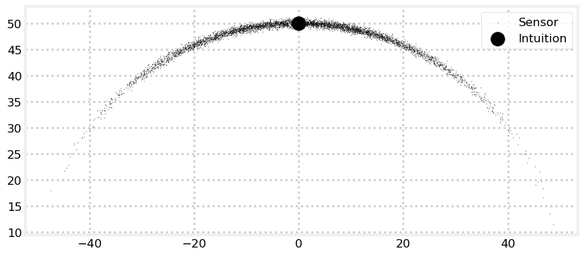
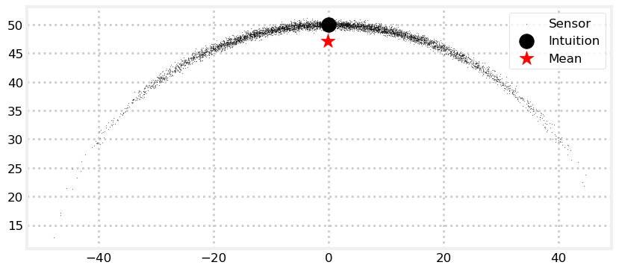
The problem with nonlinearity
For example, one distance sensor says 50km and one angle sensor says 90 degrees
We can’t use Kalman filter as is
Because nonlinearity ruins our prediction gaussianity

Slide 37
Quadcopter with nonlinear air resistance
Resistance is proportional to velocity squared and against it:

Slide 38
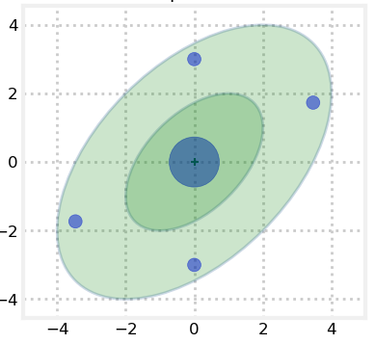
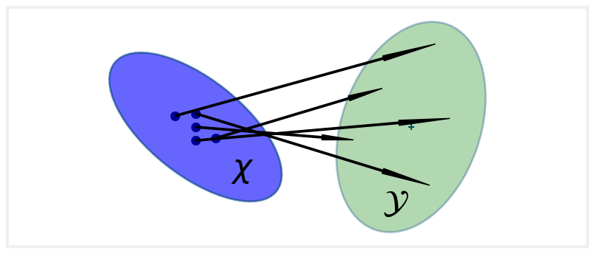
Unscented Kalman Filter

Slide 39
More nonlinear algorithms
The Extended Kalman filter
Approximate 1st order using Jacobian matrix
The Particles Filter
Simulate thesys using a lot of weighted particles
Very Robust, Very demanding
And many more variations!
My Thesis will also be one :)

Slide 40
Thank you ☺

