Slide 1
Computer haptics

Slide 2
Introduction

Slide 3
hearing
sight
smell
taste
touch
which sense is most valuable to you?
which would you relinquish last?
Notes:
- Interesting cultural differences: I once gave a talk to a group of engineers and executives from Hyundai (all Korean). The majority decision there was smell! Also, maybe their highest-ranking officer (a VP) influenced them.
- My goal is not to convince you that touch is the *most* important. Just that it *is* important, as are all the senses. By thinking about our sensory experiences, we can open up new ways of thinking about the world and our interactions with it.
- What does the sense of touch encompass? Skin + Muscles/joints. Skin is the largest organ in the body!

Slide 4
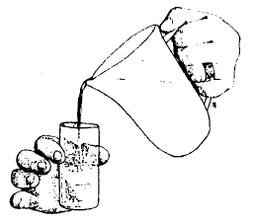
hap·tic ('hap-tik)
adj. Of or relating to the sense of touch.
[Greek haptikos, from haptesthai, to grasp, touch. (1890)]
Kinesthesia
Location/configuration
Motion
Force
Compliance
Cutaneous
Temperature
Texture
Slip
Vibration
Force
The haptic senses work together with the motor control system to:
Coordinate movement
Enable perception
Johansson and Westling
Notes:
There are two components to haptic sensation: Kinesthetics and Cutaneous components
Kinesthetic: refers to force / proprioception. It allows us to sense large scale forces, and know where our limbs our in space or where they are with respect to our own body or another object.
Cutaneous: the cutaneous information specifically refers to anything information you can gather from your fingertips.

Slide 5

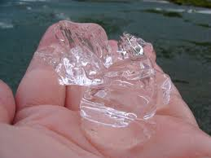
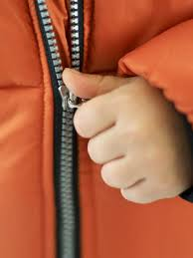
Missing tactile sense
https://www.youtube.com/watch?v=0LfJ3M3Kn80

Slide 6
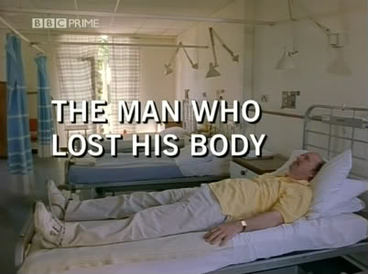
Missing kinesthesia
Ian Waterman suffers from sensory neuropathy
Notes:
http://www.youtube.com/watch?v=FKxyJfE831Q
This clip is from the 1998 BBC documentary entitled "The Man Who Lost His Body." The film follows Ian Waterman, who at 19 caught a virus that destroyed half of his nervous system, and robbed him of his proprioception. As a result, Ian is unable to mentally sense the relative positions of his limbs in space and whether or not they are in motion. The medical establishment believed that he would never walk again, but through sheer will-power Ian has been able to develop new neural pathways that enable him to function relatively normally.
http://en.wikipedia.org/wiki/Proprioception
The majority of movements and processes in a healthy adult are carried out unconsciously. However, because of Ian's disorder, he must deliberately focus all of his efforts on even the simplest of tasks (such as sitting up or displaying hand gestures).
The full BBC documentary can be found here:
Part 1: http://www.veoh.com/browse/videos/category/educational/watch/v15575943NZBjG7Fa
Part 2: http://www.veoh.com/browse/videos/category/educational/watch/v15575944ra4F58Ha

Slide 7
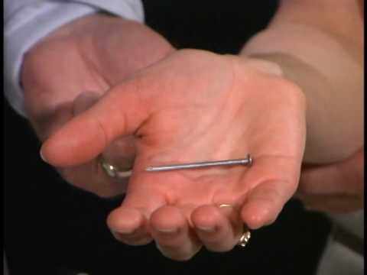
Stereognosis
The mental perception of depth or three-dimensionality by the senses, usually in reference to the ability to perceive the form of solid objects by touch.
Klatzky et al., 1985 – 100 objects are identified within 2 sec
Astereognosis – neurological disorder
  Following stroke and other

Slide 8
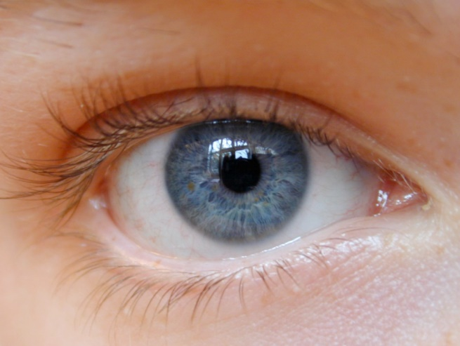
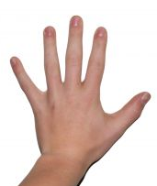
sight
centralized
broad
passive
cognitive
touch
distributed
narrow
active
physical

Slide 9
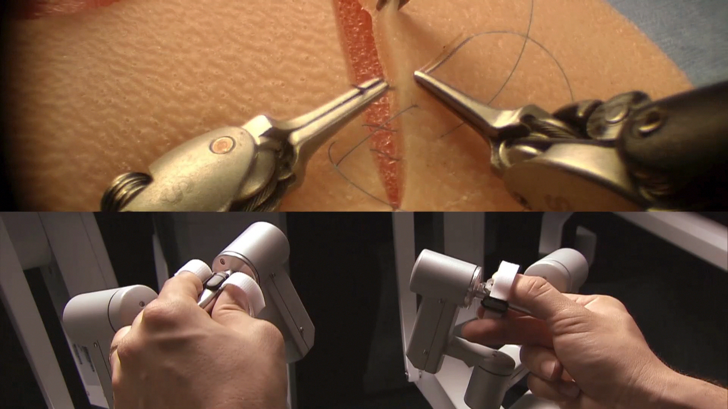
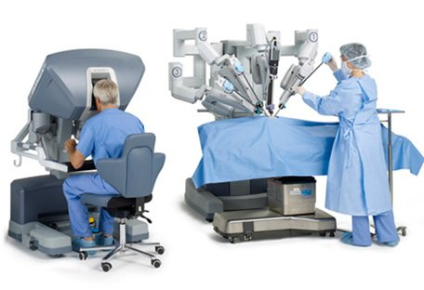
Missing haptics – robot-assisted surgery

Slide 10
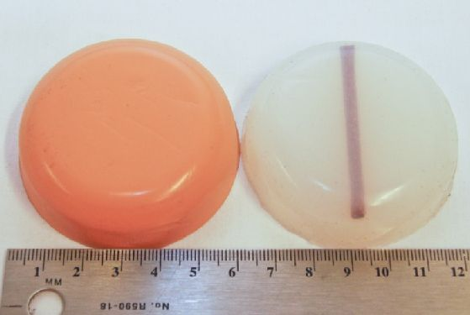
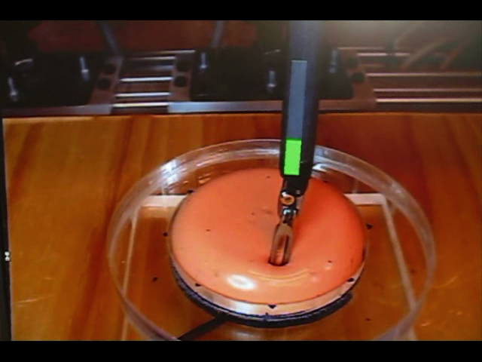
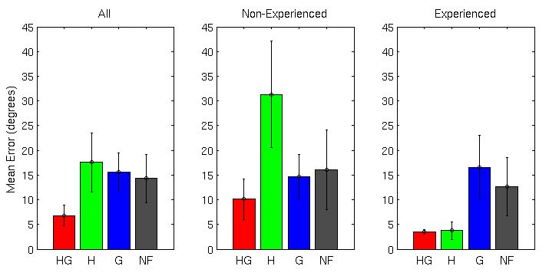
Visual substitution does not necessarily help
error (deg)
Yamamoto et al., 2009

Slide 11
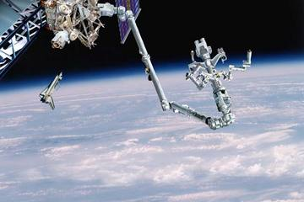
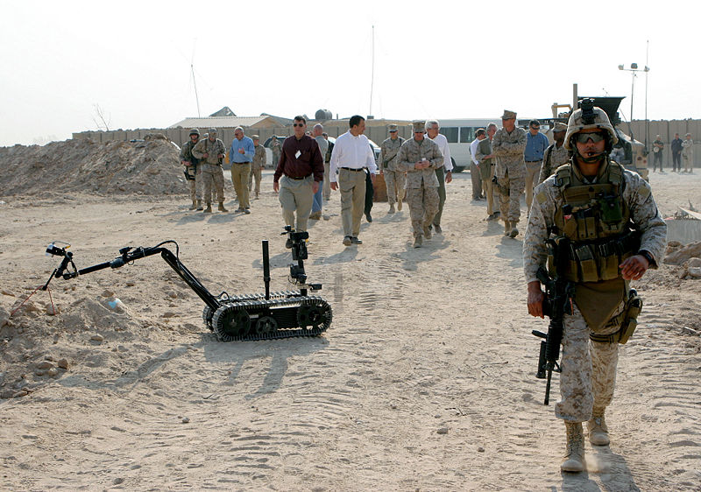
Missing haptics - teleoperation

Slide 12
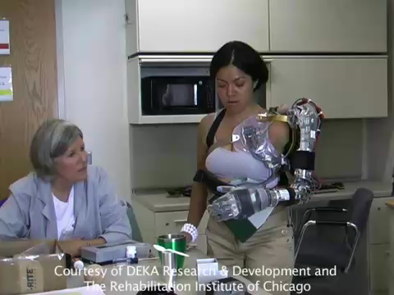
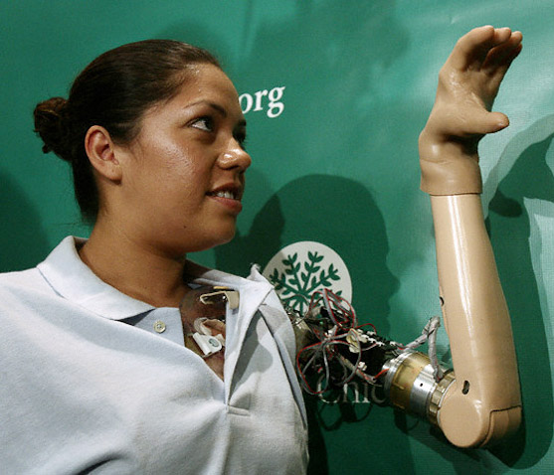
Missing haptics - prosthetics

Slide 13
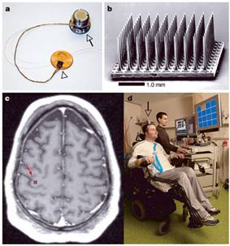
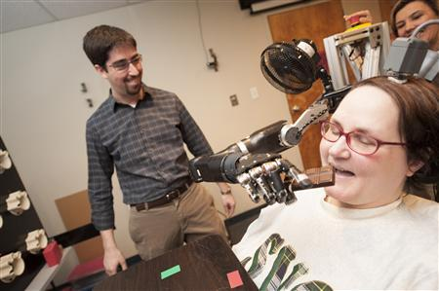
Missing haptics - BCI
https://youtu.be/AB5vYz1-T_Y

Slide 14
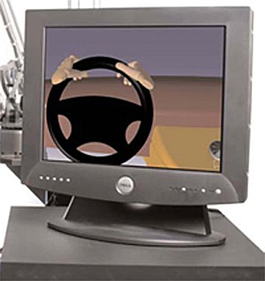
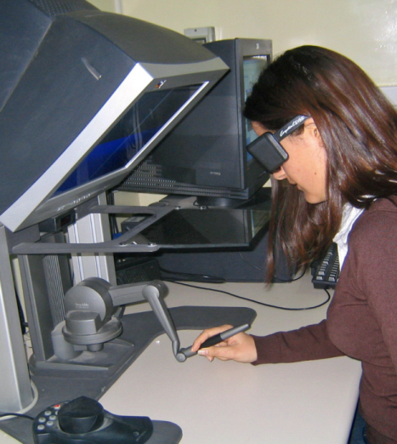
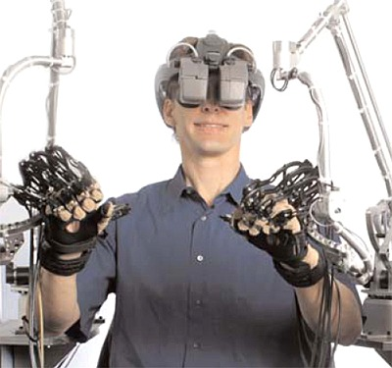
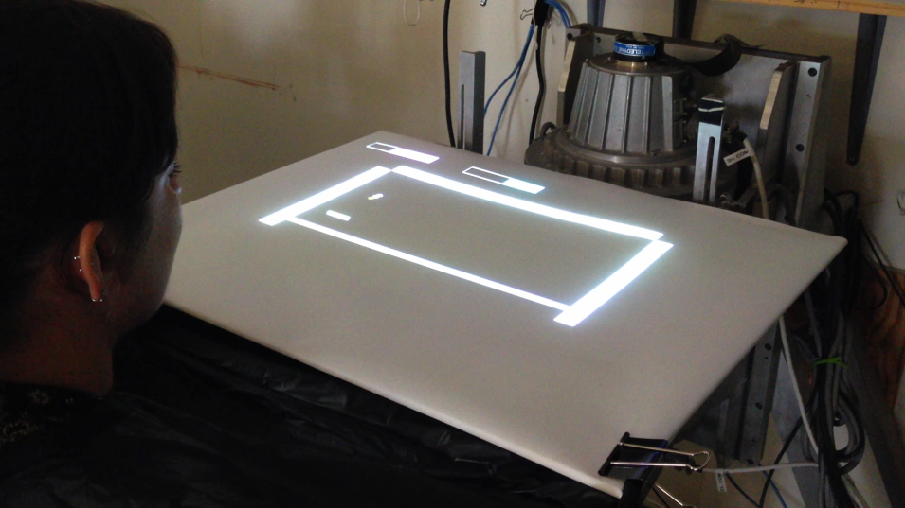
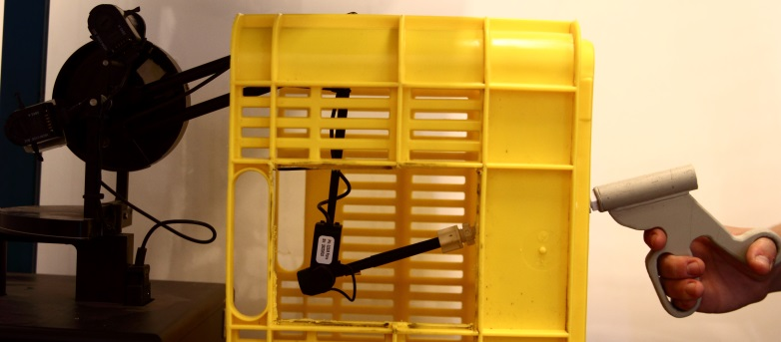
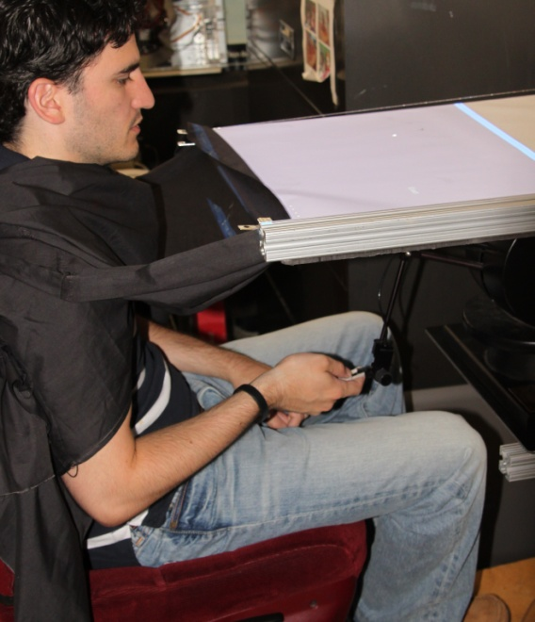
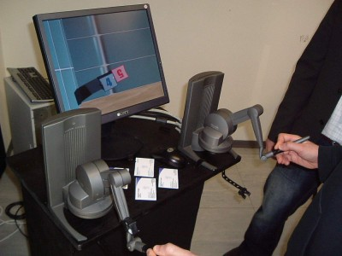
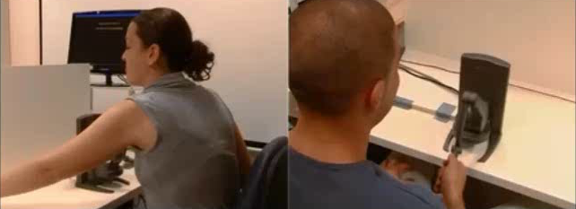
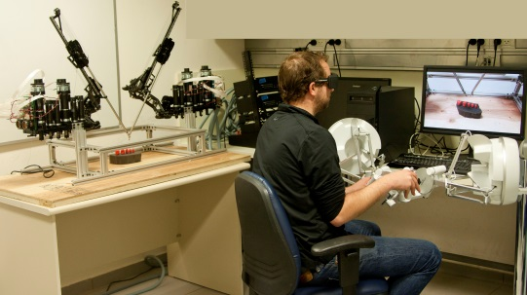

Slide 15
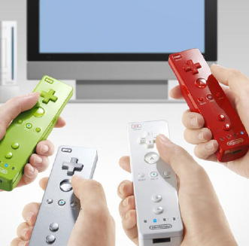
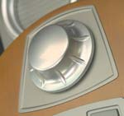
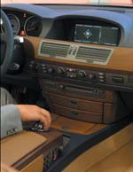
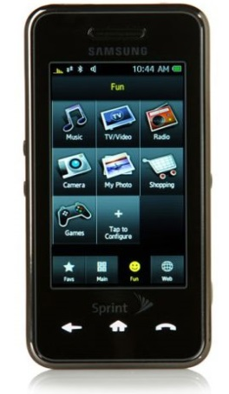
Haptic applications
Entertainment
Human-Computer Interfaces
BMW
Nintendo
Samsung

Slide 16
Teleoperation

Slide 17
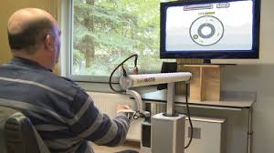
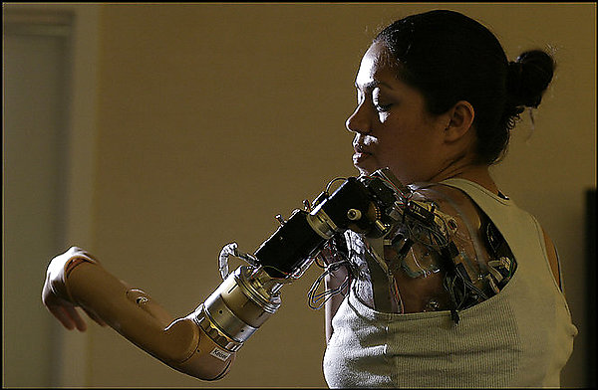
Rehabilitation and prosthetics

Slide 18
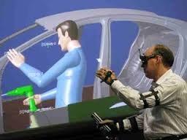
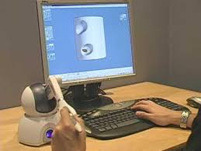
Computer-aided design
Boeing Phantom Works

Slide 19
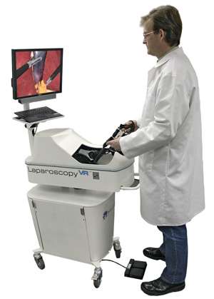
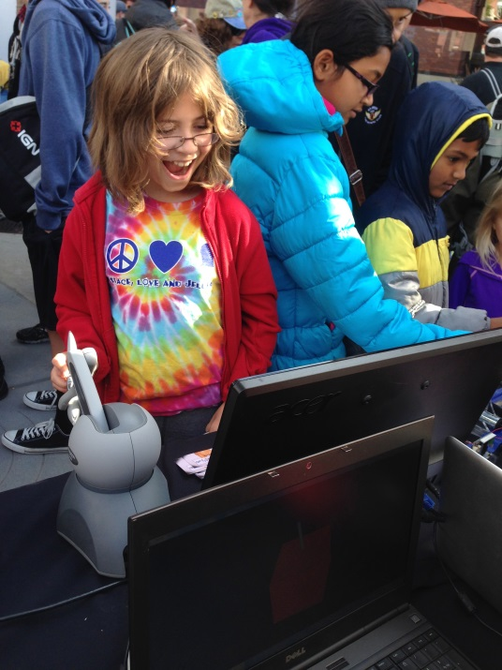
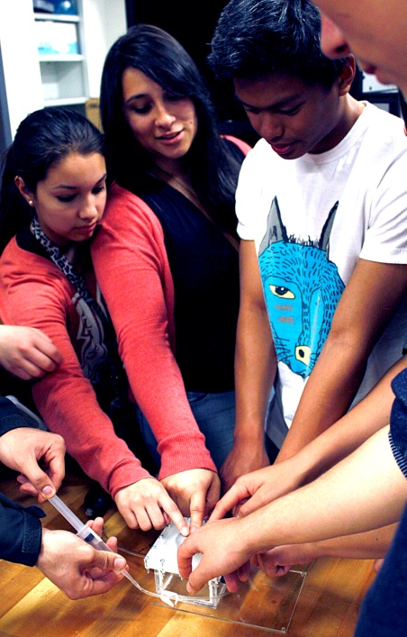
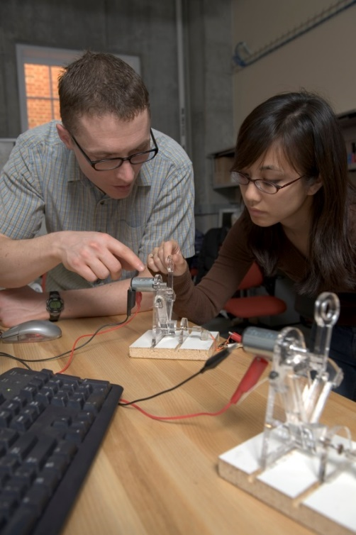
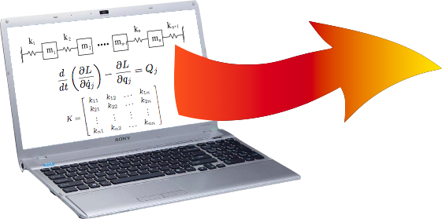
Education
Immersion

Slide 20

Computer haptics
The goal of haptic rendering is to enable a user to touch, feel, and manipulate virtual/remote objects through a haptic interface
  Simple static geometry
  Surface texture
  Deformable shapes
  Dynamic behavior

Slide 21
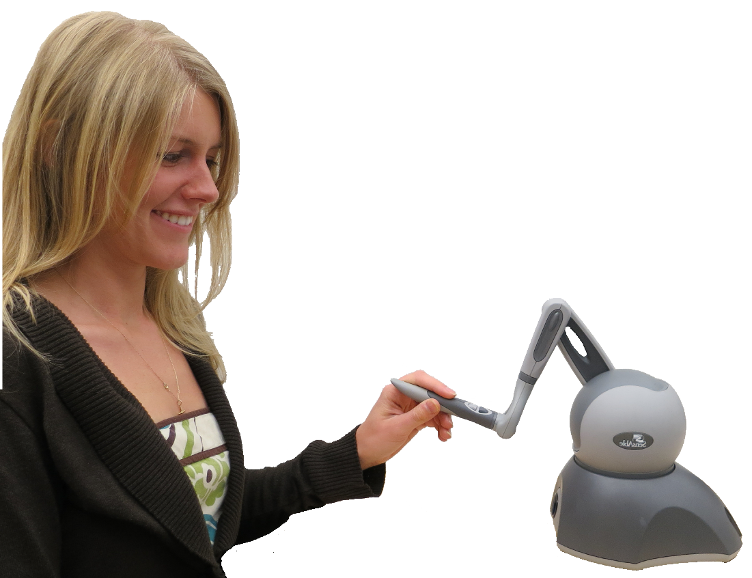
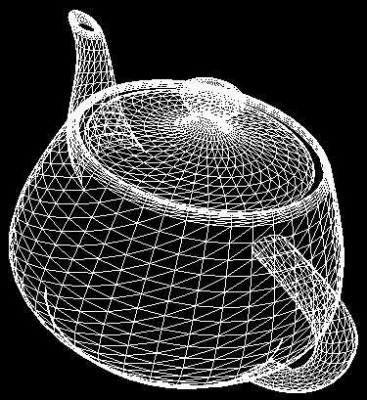
Haptic loop – virtual reality
Sensing of user input:
motion, force, EMG
user
haptic
device
Actuation to convey touch information:
kinesthetic, tactile
Virtual
environment rendering algorithm

Slide 22

Haptic loop – teleoperation
Sensing of user input:
motion, force, EMG
user
haptic
device
Actuation to convey touch information:
kinesthetic, tactile
Teleoperated
environment sensing

Slide 23
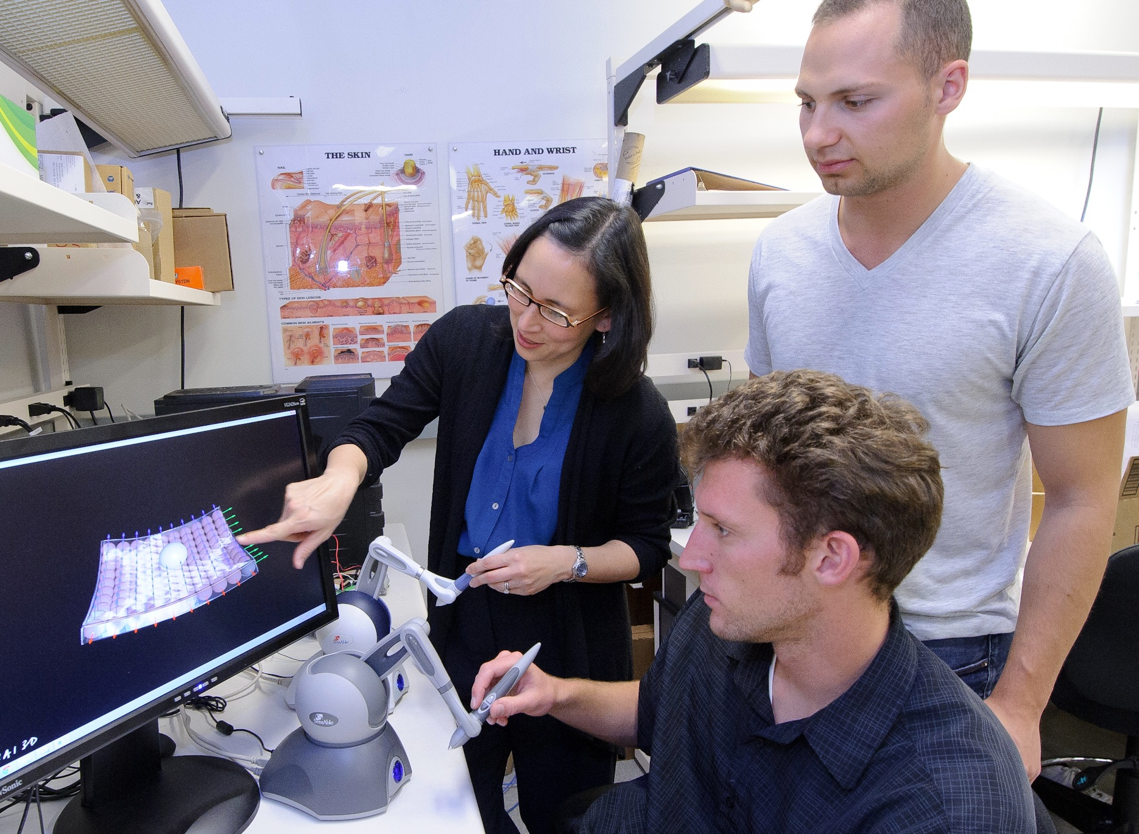
Multidisciplinary haptics
Robotics and telerobotics
Computational geometry and computer graphics
Psychophisics, cognitive sciences, and neuroscience
Design
Algorithms
Requirements

Slide 24
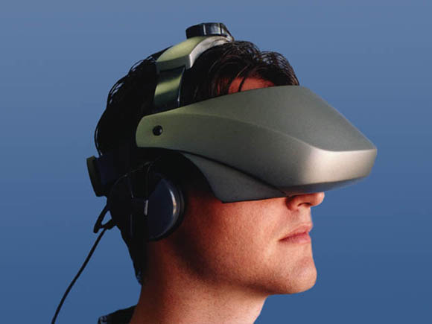
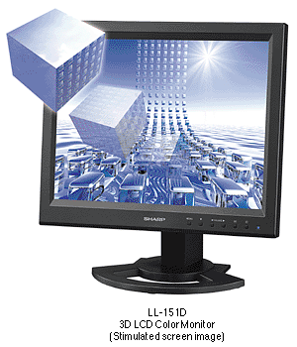
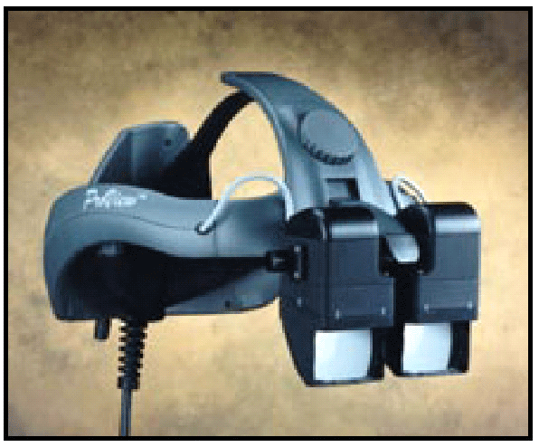
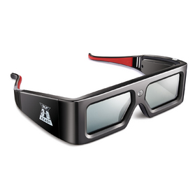
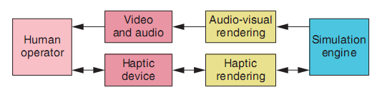
Virtual reality application structure
Visual: screen, head mounted display
Audio: speakers, headphones
30Hz
1KHz

Slide 25
Haptic device design

Slide 26
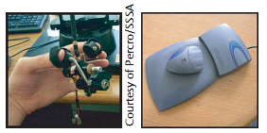
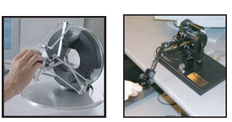

Haptic device
Exchanges energy with the user

Slide 27


Haptic device classification
Grounding location
  Interdigital devices, body-based exoskeletons, ground-based force reflecting joysticks, and desktop devices
Mechanical behavior
  Impedance: read position, send force
    Cheap, simple design
      Sensable phantom
  Admittance: read force, send velocity/position
    High forces
      Haptic Master

Slide 28
Haptic device classification
Number of DOF’s
  Motion
    Sensed or not sensed
  Force
    Actuated or not actuated
Sensable Phantom Desktop
  6 sensed motion DOF’s and 3 actuated DOF’s

Slide 29
Haptic device classification

Slide 30
Good haptic device
Inertia and friction – low
Back-drivable
Kinematics - minimal constraints on motion
Symmetric inertia, friction, stiffness, and resonate frequency properties
Balanced range, resolution, and bandwidth of position sensing and force reﬂection
Proper ergonomics
  Pain, or even discomfort, can distract the user, reducing overall performance.

Slide 31
Quantifying haptic device performance
Manipulability – product of singular values of Jacobian
Mechanism isotropy – the ration between the largest and the smallest singular values of the Jacobian
Minimum force output – the maximum of force output in the worst direction

Slide 32









Sensors
Encoders
Joint position, velocity
Resolution affects also maximum stable stiffness
Magnetic sensors
Force sensors
Strain gouge, load cell
Calibration, drift, thermal sensitivity

Slide 33


Actuators and transmission
Low inertia, low friction, low torque ripple, back-driveability, low backlash
Use a good motor!
Capstan drive
Friction drive

Slide 34
Haptic paddle example
500 counts per turn, quadrature leads to 2000 counts per turn, 2.24x10⁻⁵m resolution
Desired current
Current amplifier
Current to motor
Torque from motor
Force through capstan
Torque on handle

Slide 35
Haptic rendering

Slide 36
Rendering cycle
Sensing
Kinematics
Collision detection
Determining surface point
Force calculation
Statics
Actuation

Slide 37


System architecture
Avatar: virtual representation of the haptic interface through which the user physically interacts with the virtual environment.
HIP – haptic interaction point

Slide 38

System architecture
Between HIPs and objects
1KHz
Notes:
Low-level control algorithms sample the position sensors at the haptic interface device joints.
These control algorithms combine the information collected from each sensor to obtain the position of the device-body interface in Cartesian space
The avatar’s position inside the virtual environment.
The collision-detection algorithm uses position information to ﬁnd collisions between objects and avatars
Report the resulting degree of penetration or indentation.
The force-response algorithm computes interaction forces between avatars and virtual objects
The force-response algorithm sends interaction forces to the control algorithms
Apply them on the operator through the haptic device while maintaining a stable overall behavior

Slide 39
Force response algorithms
Rigid objects
Soft, deformable objects
Dynamic objects
Haptic playback
More than one operator

Slide 40


1 DOF interaction
Examples:
  Door knob, scisors, pressing syringe piston
Virtual wall

Slide 41

Staircase effect
Low stiffness – soft wall
High stiffness – unstable interaction

Slide 42





3 DOF interaction
Vector fields – one to one mapping between position and force
IHIP, god object, proxy algorithms that take into account the history of interaction

Slide 43



Surface detailes
Smooth surfaces – force shading
Friction
Texture
  Image based – texture map of heights wrapped around the object
  Noise, fractals

Slide 44

More than 3 DOF – ray based
The interaction is with a line segment
Models of long tools
  Surgical instruments simulation

Slide 45

More than 3 DOF - complex probing tool
A set of points on the probing tool is simulated
Appropriate for models of mechanical assembly

Slide 46



Deformable objects
Geometry based
  Fast, easy to implement
  Don’t simulate the mechanics
    Vertex v. spline
Physics based
  Realistic behavior
  Computationally expensive
    Particle based, Finite elements based
Loose coupling between force and position deformation

Slide 47




Dynamic objects

Slide 48


Shared haptic operation
Karniel, Nisky, Avraham, Peles, and Levy-Tzedek, 2010

Slide 49

Vibration feedback
Render texture
Render contact transients and increase perceived stiffness
Sensory substitution

Slide 50


Example Verro-touch
Katherine Kuchenbecker

Slide 51

Wearable Haptics

Slide 52

Non-grounded Haptics

Slide 53


Tactile Haptics
https://youtu.be/610iTKlYBVM

Slide 54
Tactile arrays

Slide 55

TPAD – ultrasonic friction modulation

Slide 56



http://hapkit.stanford.edu

Slide 57

Particle Jamming Haptics

Slide 58

Particle Jamming Haptics

Slide 59



The future of haptics
Journal
  IEEE Transactions on Haptics
International conferences
  EuroHaptics 2016
    http://www.eurohaptics.org/
  Haptics Symposium
    http://2016.hapticssymposium.org/
  WorldHaptics 2017
    http://www.worldhaptics2017.org/
Technical committee on haptics
  http://www.worldhaptics.org/
IEEE the Institute, March 2008
Notes:
מה שמערכות הניתוח הרובוטי (ולכן גם הניתוח מרחוק) לא מספקות כרגע הוא תחושת המגע.
רופאים רבים מדווחים כי פרוצדורות היו מתבצעות יותר טוב ויותר מהר אם תחושת המגע ומשוב הכוח היו זמינות
מחקרים רבים שנעשו בהפעלה מרחוק דו-צדדית העלו כי הביצועים טוביםן יותר אם הכוח שמוזן הוא אמין, אינפורמטיבי ולא מייצר בעיות של יציבות

Slide 60
References
Basdogan, C. and M. A. Srinivasan (2002). "Haptic Rendering in Virtual Environments." Handbook of Virtual Environments. K. Stanney. London, Lawrence Earlbaum, Inc.: Chapter 6, pp. 117-134
Biggs, J. and M. A. Srinivasan (2002). "Haptic Interfaces. Handbook of Virtual Environments." K. Stanney. London, Lawrence Earlbaum, Inc.: Chapter 5, pp. 93-116.
Salisbury, Conti, and Barbagli (2004). “Haptic rendering: Introductory concepts” in IEEE Computer Graphics and Applications, pp. 24-32
Massie and Salisbury (1994) “The PHANTOM Haptic Interface: A Device for Probing Virtual Objects” Proceedings of the ASME Winter Annual Meeting, Symposium on Haptic Interfaces for Virtual Environment and Teleoperator Systems, Chicago, IL, Nov. 1994.
Hannaford B., and Okamura A. (2017), “Haptics” in: Handbook of Robotics.

