Slide 1
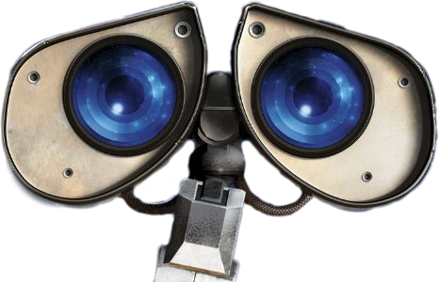
How do robots see?
Golan Levy • 04.11.2019

Slide 4
Structured Light

Slide 5
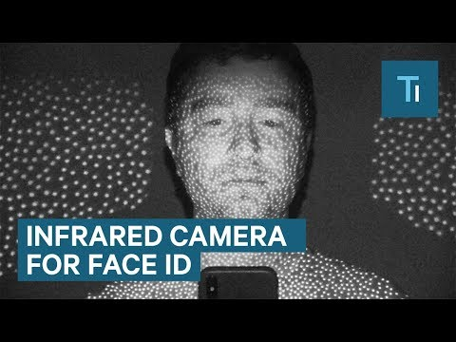

Slide 7
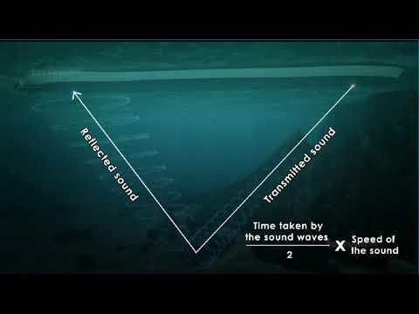
Sonar (Sound navigation and ranging)

Slide 8
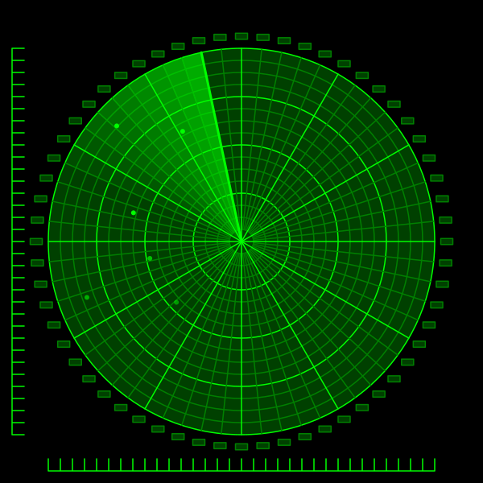
Radar (Radio detection and ranging)

Slide 9
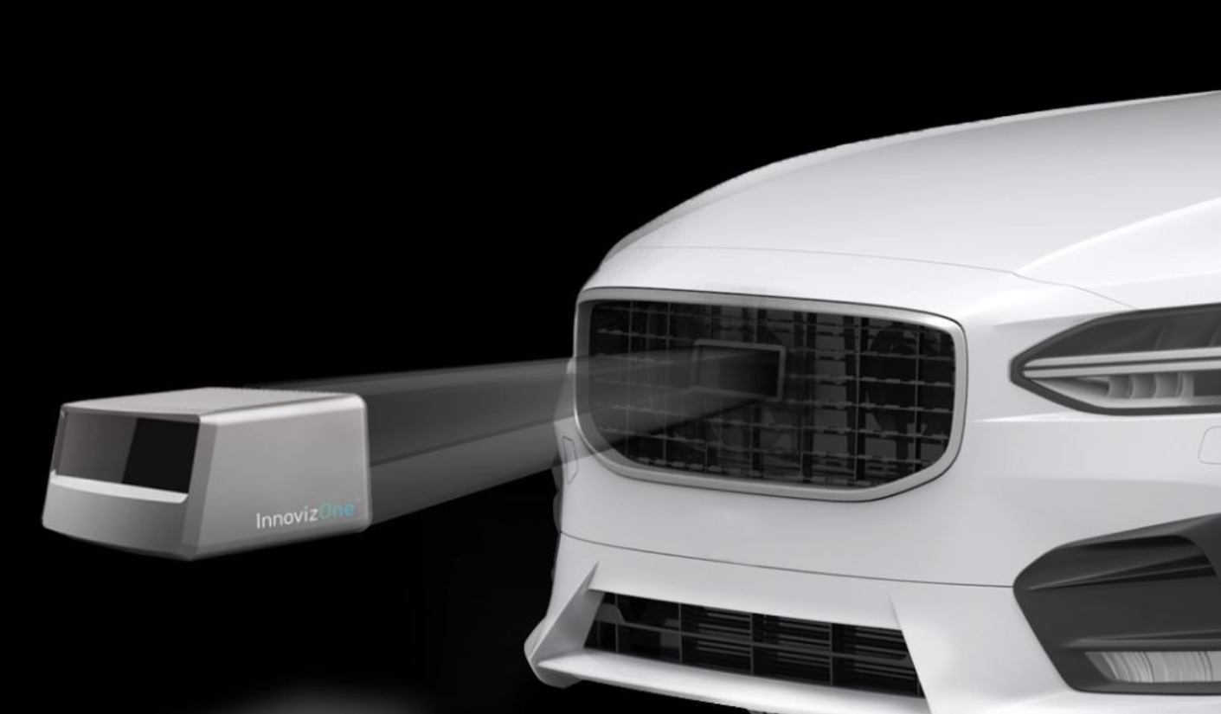
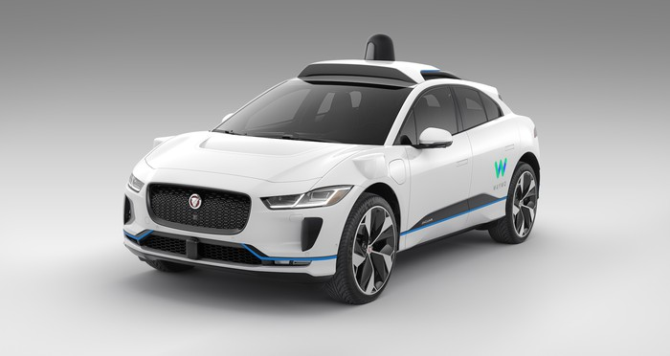
Lidar (Light detection and ranging)
Lidar (Light and radar)

Slide 10
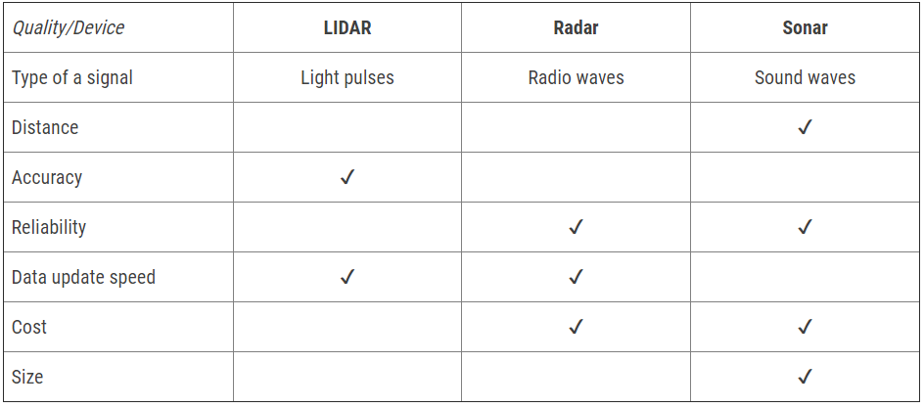
https://cyberpulse.info/lidar-vs-radar-vs-sonar/#comparison-of-object-detection-systems

