Slide 1
The Minimum Constraint Removal Problem
Applications, algorithms and complexity analysis
Based on this article by Hauser, University of Illinois
Adar Gutman, TAU

Slide 2
Introducing the problem

Slide 3
MCR - introduction
Motion planners generally tend to operate in a binary fashion -
Output a valid path from source to destination, if such a path exists
Output that no such path exists otherwise
What if we wanted to explain the reason no such path exists? Or how close we were to finding a path?

Slide 4
MCR - introduction continued
When no path exists from source to destination, MCR is the problem of finding the minimum amount of obstacles we need to remove in order to form a valid path from source to destination.
Intuitively, MCR allows us to reason with failure in producing a valid path, and further our understanding of the obstacle space.

Slide 5
Formalizing the problem

Slide 6
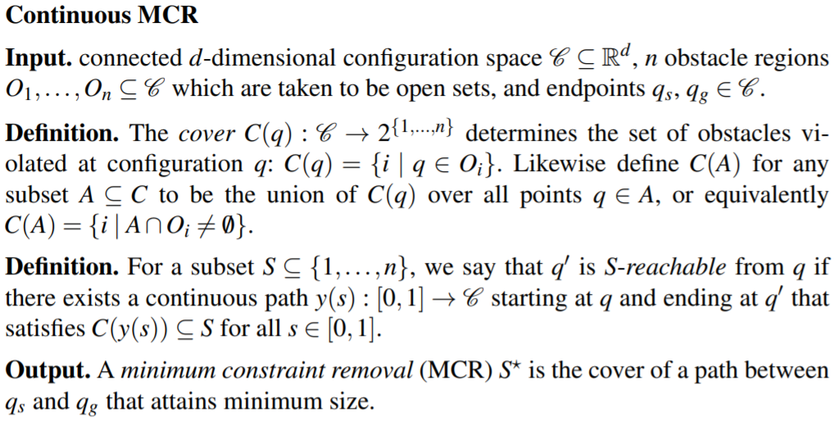
MCR - formal introduction
We present a formal introduction to the continuous and discrete MCR problem

Slide 7
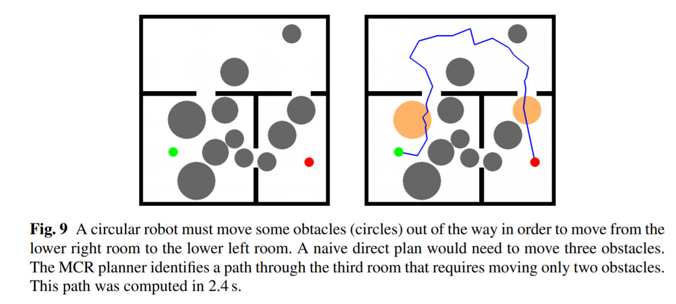
Geometric illustration I

Slide 8
MCR - some more formal discussion
MCR is a generalization of the classical Piano Movers Problem, Because S* = ∅ iff there exists a feasible path from source to destination.
If S* ≠ ∅, then S* ‘explains’ the infeasibility of the motion planning.

Slide 9
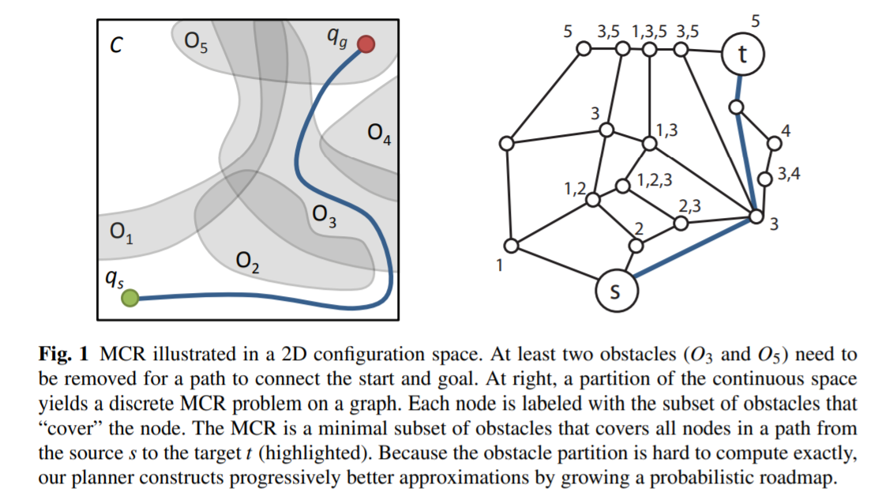
Geometric illustration II

Slide 10
Discussion about complexity

Slide 11
Discrete MCR -
Complexity
Analysis
Given a universe U and a family S of subsets of U, {S1,...Sn}, SET-COVER is the problem of determining the minimum k required such that we can find k sets in S that cover U.
Example:
SET-COVER is NPC: it appears in Richard Karp’s list of 21 NPC problems.
An instance of SET-COVER can be polynomially reduced to an instance of MCR by constructing the appropriate graph.
The reduction is found here.
Decision version of Discrete MCR is in the complexity class NPC, so we are not going to find efficient exact algorithms.
Showing it is NP is very simple: given a certificate S of size k for S-reachability, we look at the subgraph corresponding to S and perform BFS on it.
Showing it is NP-hard requires reduction from set cover problem.

Slide 12
What can we do with NPC problems?
Use approximate algorithms!

Slide 13
Discrete MCR - algorithms and analysis
Best-first approach, similar to A*, can be used to solve discrete MCR exactly:
Every state is given by a vertex/subset pair
corresponds to the subset of constraints violated in some path From source to v
Start from initial set and vertex, then increase S in a best-first fashion by enumerating all of its neighbor nodes
Notice that each vertex can be reached by many paths, each corresponding to a unique subset: worst case is exponential number of state pairs for each vertex
Worst case time complexity is

Slide 14
Discrete MCR - algorithms and analysis
We can vastly improve by using approximate greedy search:
Quite similar to the exact approach, main difference is that for each vertex v, only the subset of constraints with minimal size is kept
Guaranteed to expand each vertex only once, therefore time complexity is O(|G|n)
Empirically very fast and practical, capable of solving much larger problems than exact search

Slide 15
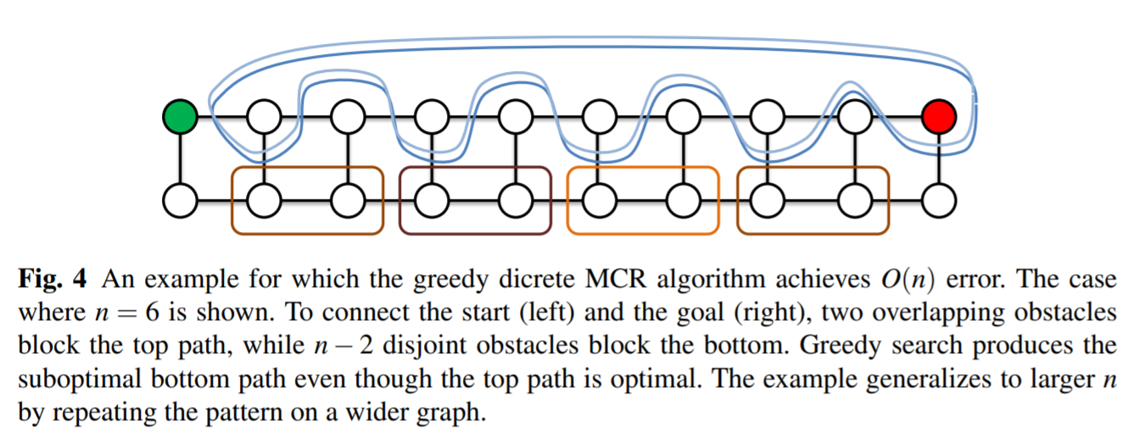
Discrete MCR - algorithms and analysis
Since greedy search is approximate, its output may be erroneous. Worst case error O(n), see illustration to convince yourself. SET-COVER can be done with O(logn) error, so MCR is harder to approximate.

Slide 16
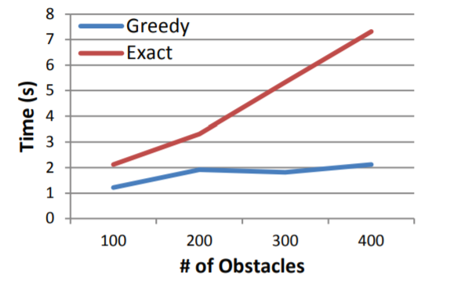
Discrete MCR - algorithms and analysis
Running times for greedy vs. exact algorithm on the same grid

Slide 17
Back to the continuous setting

Slide 18
Continuous MCR - revisited
We define the two following routines on the configuration space:
Cover(q), which computes the set of constraints violated at configuration q
EdgeCover(q, q’), which computes the set of constraints violated along a straight-line path from configuration q to configuration q’
We maintain a probabilistic roadmap, G, a network of configurations connected by straight line paths. Reachability in G approximates actual reachability.
We say that a node q is (G, k) reachable if there exists a path in G from the destination to q with a cover of size at most k
A good exploration strategy constructs G such that k reachable nodes are likely to be (G, k) reachable: ideally (G, k)-reachable ⟺ k-reachable

Slide 19
Continuous MCR - revisited
Our planner grows G, the probablistic roadmap, by expanding from (G, k) reachable nodes for some exploration limit k.
PRM-like strategy connects new nodes to their nearby neighbors
These connections improve the connectivity of the roadmap and the quality of the (G, k) approximation
The Expand-Roadmap procedure grows the roadmap while limiting the domain of exploration such that each added node is (G, k) reachable

Slide 20
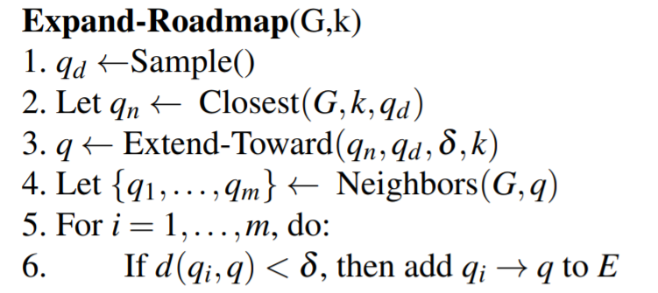
Continuous MCR - revisited
The Expand-Roadmap routine operates by first generating a random sample in line 1 and extending an edge from the closest (G, k) reachable milestone towards the sample, at lines 2-3.
In lines 4-6, the resulting leaf node q is then connected to nearby milestones in the roadmap.
Expand roadmap uses several subroutines, which are explained in the next slide.

Slide 21
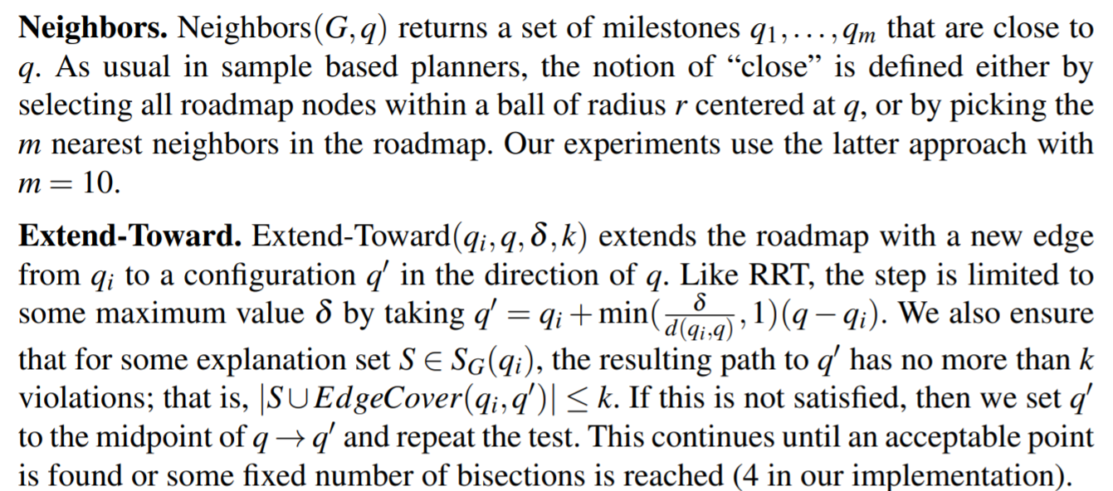
Continuous MCR - revisited

Slide 22
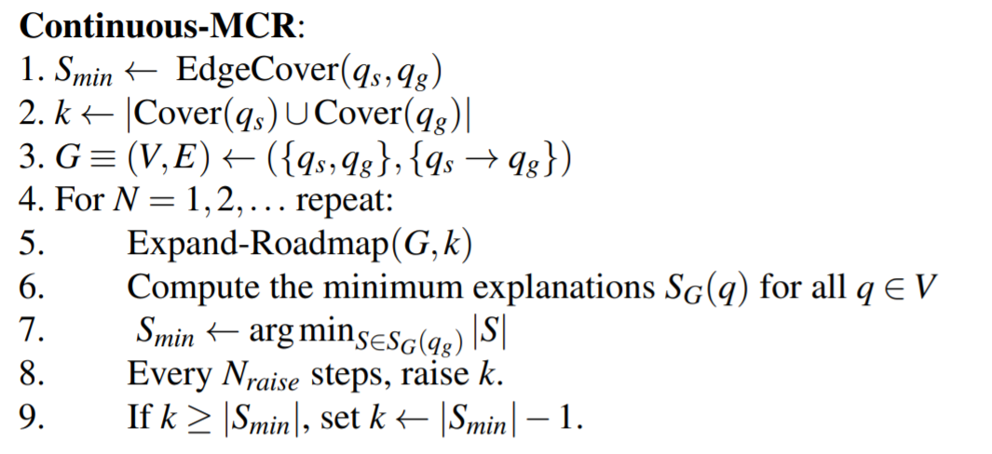
Continuous MCR - revisited
We now present the Continuous-MCR algorithm. Lines 1-3 initialize the probabilistic roadmap G to a single edge from source to destination, and sets the exploration limit k to a known lower bound - size of constraints violated at start and at end.
Line 5 expands our roadmap, and line 6 uses discrete MCR (either greedy or exact search) to compute the optimal constraint-violating path for every vertex in the roadmap. Line 7 updates the best explanation (a technicality) and lines 8-9 improve the exploration limit.

Slide 23
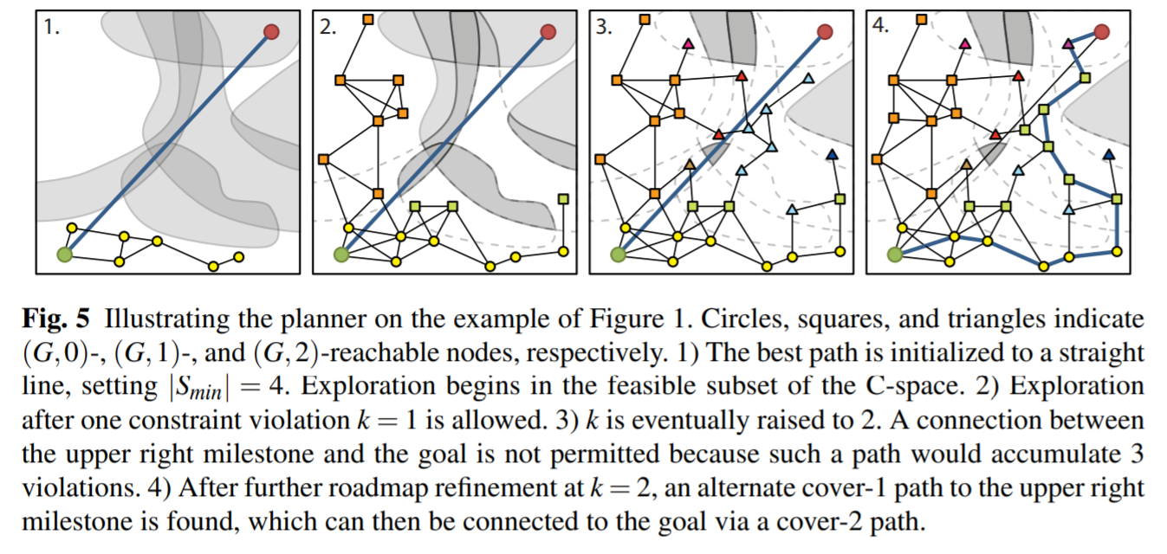
Geometric illustration III

Slide 24
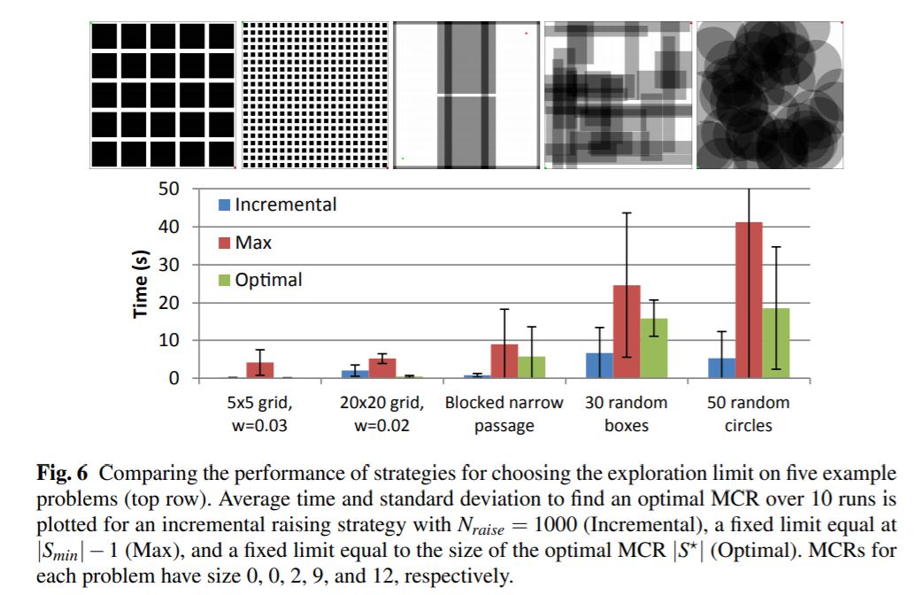
Empirical results about rate of convergence to solution

Slide 25
Applications of MCR

Slide 26
Applications of MCR
A robot with k DOF moving among n movable obstacles: it aims to move the least amount of obstacles from its path.
A robot with k DOF moving among n obstacles, but a collision-free path does not exist: assume every collision degrades the robot quality, and it must traverse in some path. It is only reasonable for the robot to traverse the path of minimal collisions found by MCR.
Robot may communicate to human operator which obstacles must be removed.
Explanations of planner failures may help human technicians to debug robot crashes.
A robot capable of shoveling snow must create a snow-free path as quickly as possible. Can you think of more applications?

Slide 27
Questions?

Slide 28
Thank you for
your attention!

