Slide 1
Efficient Algorithms for Optimal Perimeter Guarding
Si Wei Feng∗ , Shuai D. Han∗ , Kai Gao† and Jingjin Yu∗
∗Department of Computer Science, Rutgers University at New Brunswick, Piscataway, New Jersey, U.S.A.
† School of Mathematical Sciences, University of Science and Technology of China, Hefei, Anhui, China
Rss 2019: http://rss2019.informatik.uni-freiburg.de/papers/0007_FI.pdf
Full paper at: https://arxiv.org/abs/1905.04434

Slide 2
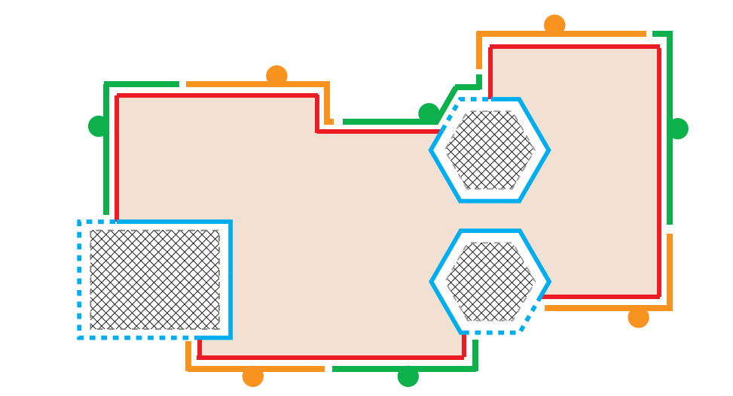
Problem description and examples
The optimal Perimeter Guarding (OPG) problem is to find the best partition to regions s.t. the maximal region a robot needs to guard is minimized.

Slide 3
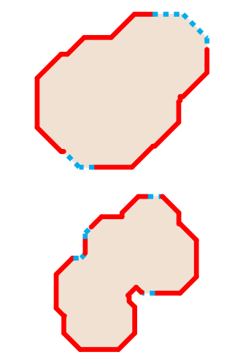
Basic notations
$n$ - number of robots
$m$ - number of regions
$q_{i}$ - number of connected components in region $i$

Slide 4
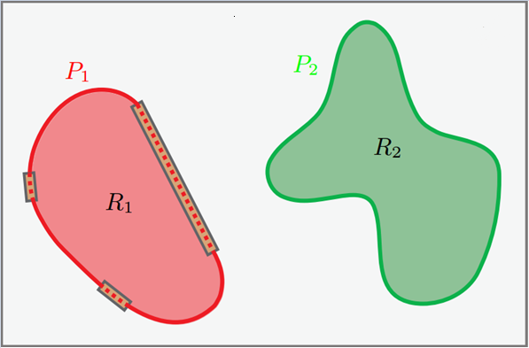
Notations
$m$regions $R=\left\{R_{1},…,R_{m}\right\}$
$∂R_{i}$ is $R_{i}$ boundary
$∂R_{i} ≅ 𝕊^{1}$
$∂R=\left\{{∂R}_{1},…,{∂R}_{m}\right\}$
$P_{i} \text{⊂} ∂R_{i}$ is called the perimeter of $R_{i}$
$C_{i}$ is the part covered by robot $i$ in a given cover
$l^{∗}$ is the maximal length of any $C_{i}$ in an optimal cover

Slide 5
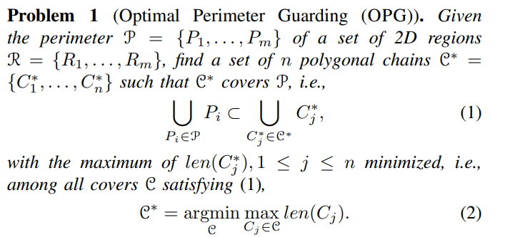
Optimal Perimeter Guarding (OPG)
Given the perimeter….

Slide 6
Perimeters Containing Single Components

Slide 7
Perimeters Containing Single Components

Slide 8
Perimeters Containing Single Components
In a potential optimal solution:
For a given region $R_{i}$, each of the $n_{i}$ robots assigned to guard it must each guard a length $l_{i}=len(P_{i})/n_{i}$
For (at least) one region $R_{i}$, it holds that $l_{i}$ = $l^{∗}$ (the maximal single robot coverage length)
Thus, one can try for each $R_{i}$ all possible $1 ≤ n_{i}≤ n$and find the minimum $l_{i}=len(P_{i})/n_{i}$that is feasible. Such $l_{i}$ and $n_{i}$ will be named $l_{i}^{c}$and $n_{i}^{c}$respectively.
$l^{∗}$ will be the smallest among all computed $l_{i}^{c}$.

Slide 9
Improvements
Can use binary search over $1 ≤ n_{i}≤ n$to find $l_{i}^{c}$ the minimum $len(P_{i})/n_{i}$that is feasible for a given region $R_{i}$
If we start by first examining the longest $P_{i}$, only up to one candidate $n_{i}^{c}$ per any remaining region $R_{i}$ has the potential to produce a better result ($l^{∗}$).

Slide 10
Examining the longest $P_{i}$ first
Assume $P_{1}$ is the longest perimeter
Doesn’t improve result over $l_{1}^{c}$
Not feasible

Slide 11
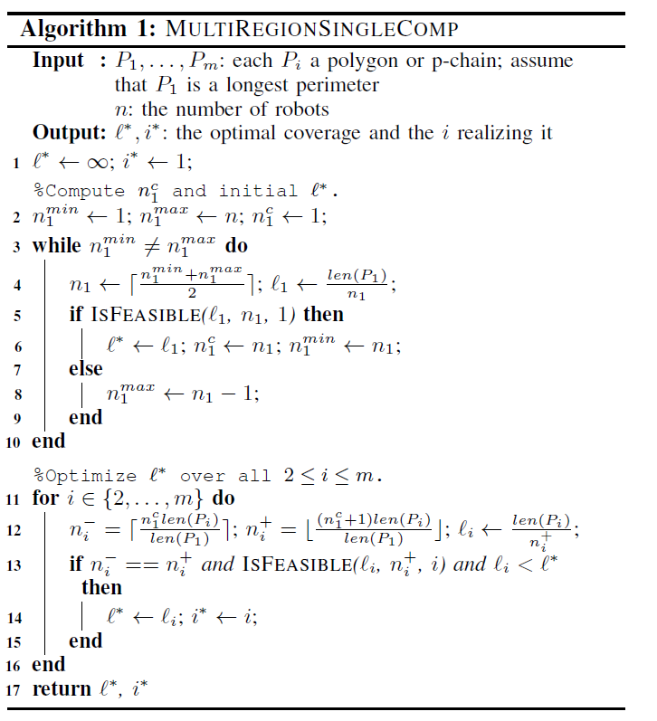
Perimeters Containing Single Components
Running time: $O(m\left( \log\left(n\right)+\log\left(m\right) \right))$

Slide 12
Perimeters Containing Single Components

Slide 13
Single Perimeter Containing Multiple Components

Slide 14
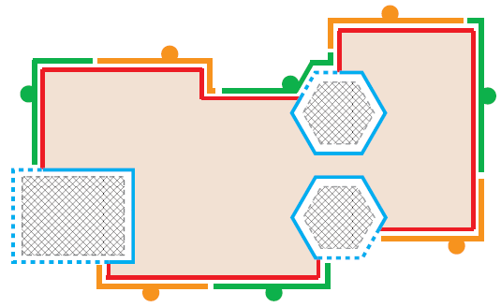
Single Perimeter Containing Multiple Components
We Know how to cover multiple regions without gaps, why not think of every connected component as a single region without gaps?

Slide 15
Lemma – No gap needs to be “partially covered” by a robot
For a perimeter $P$, there exists an optimal cover $C^{∗}=\left\{C_{1}^{∗}, …, C_{n}^{∗}\right\}$ such that, for any gap $G$ and any $C_{j}^{∗}∈C^{∗}$, $C_{j}^{∗}∩G=G or C_{j}^{∗}∩G=∅$

Slide 16
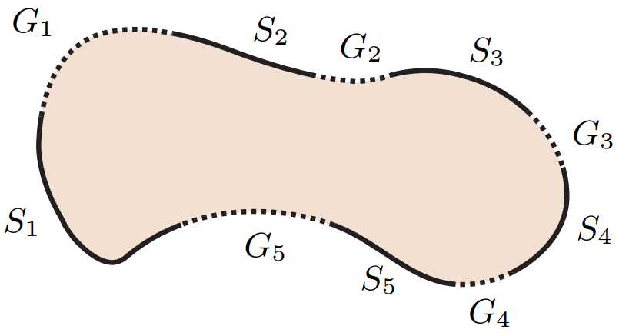
Notations 2.0
Let a perimeter $P$ have $q$ segments $\left\{S_{1},…,S_{q}\right\}$ which are divided by $q$ gaps $\{G_{1},…,G_{q}\}$
Example:
A region with five segments $S_{1},…,S_{5}$and five gaps $G_{1},…,G_{5}$

Slide 17
Proposition 2 - Some gap must be skipped

Slide 18
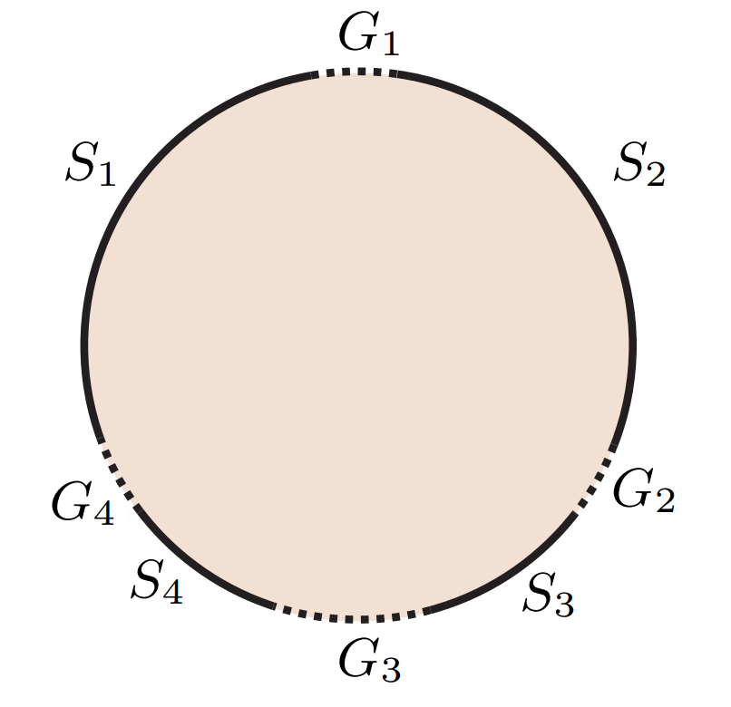
Proposition 3 - There are OPG instances in which the biggest gap must be covered.
The optimal cover with $n=3$ is to have $C^{∗} = \{S_{1},S_{2},(S_{3} ∪ G_{3} ∪ S_{4})\}$
In $C^{∗}$ we have $l^{∗}=len(S_{1})$
Red cover: $$l^{∗}=len\left(S_{1}\right)$$
Blue cover:
$l^{∗}≥\frac{3len\left(S_{1}\right)+0.5len\left(G_{1}\right)}{3}$ blue cover is worse
$$len\left(G_{3}\right)= 1.5len(G_{1})$$

Slide 19
Proposition 4

Slide 20
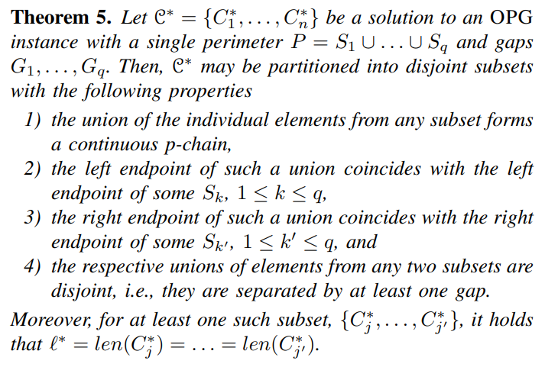
Theorem 5

Slide 21
Single Perimeter Containing Multiple Components
A baseline algorithm:
For all $1≤k,k^{′}≤q$ denote the part of $∂R$ from $S_{k}$ to $S_{k^{′}}$ following a clockwise direction and including the gaps as $S_{{kk}^{′}}$
Theorem 5 states that for some $1≤k,k^{′}≤q,\frac{len\left(S_{{kk}^{′}}\right)}{n_{{kk}^{′}}^{c}}=l^{∗}$
To find $l^{∗}$, for each $1≤k,k^{′}≤q$ we find $n_{{kk}^{′}}^{c}$ the biggest $n_{kk^{′}}$ s.t. the problem is feasible and compute $l_{{kk}^{′}}^{c}=\frac{len\left(S_{{kk}^{′}}\right)}{n_{{kk}^{′}}^{c}}$
The smallest $l_{{kk}^{′}}^{c}$ is $l^{∗}$
Running time $O(q^{2}∗n)∗\text{O}\text{(}\text{feasibility} \text{check}\text{)}$

Slide 22
$$\text{feasibility} \text{check}$$
For checking feasibility of a particular $l_{kk^{′}}$ i.e., whether $l_{kk^{′}}$ is long enough for the rest of the robots to cover the rest of the perimeter we simply tile $n−n_{kk^{′}}$ copies of $l_{kk^{′}}$ over the rest of the perimeter.
Thus time complexity is $O\left(q^{2}∗n\right)∗O(q)=O(q^{3}∗n)$

Slide 23
Variants and results
multiple perimeters with each having a single connected component
$O(m\left( \log\left(n\right)+\log\left(m\right) \right))$
single perimeter containing multiple connected components
$O(q^{2}\log\left(n+q\right))$
multiple perimeters with each containing multiple connected components
$O\left(\sum_{1≤i≤m}{q_{i}^{2}}\log\left(n+\sum_{1≤i≤m}{q_{i}}\right)\right)$
multiple perimeters with each having a single connected component
$O(m\left( \log\left(n\right)+\log\left(m\right) \right))$
single perimeter containing multiple connected components
$O(q^{2}\log\left(n+q\right))$
multiple perimeters with each containing multiple connected components
$O\left(\sum_{1≤i≤m}{q_{i}^{2}}\log\left(n+\sum_{1≤i≤m}{q_{i}}\right)\right)$

Slide 24
Thank you for your time

