Slide 1
Tabletop Rearrangements with Overhead Grasps
Presented by: Nave Tal
Based on a paper by:
Shuai D. Han, Nicolas M. Stiffler,
Athanasios Krontiris,
Kostas E. Bekris, Jingjin Yu

Slide 2
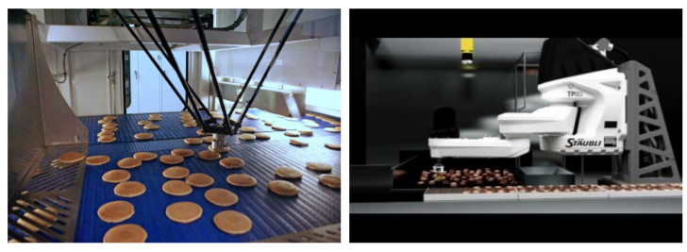
The Problem:

Slide 3
The Problem:
Given feasible start and goal arrangements $R_{S}$, $R_{G}$ for objects $O=\{o_{1}, . . . , o_{n}\}$ on a tabletop, determine a sequence of collision-free pick-and-place actions with overhand grasps $A = (a^{1} , a^{2} , . . .)$that transfer $O$ from $R_{S}$ to $R_{G}$.
For a manipulation action $a^{i}$, the incurred cost is $c_{a^{i}}=c_{m}d_{e}^{i}+c_{g}+c_{m}d_{l}^{i}+c_{r}$
$c_{m}$ is the cost of moving the manipulator
$c_{g},c_{r}$ are the costs of grabbing and releasing an object, respectively
$d_{e}^{i},d_{l}^{i}$ are the distances moved while not carrying and while carrying an object, respectively.
Total cost: $c_{T}=\sum_{i=1}^{|A|}{\left(c_{a^{i}} \right)}=\left|A\right|\left(c_{g}+c_{r}\right)+c_{m}(\sum_{i=1}^{\left|A\right|}{\left(d_{e}^{i}+d_{l}^{i}\right)+d_{f}})$
We assume that $c_{g},c_{r}≫c_{m}$
So we want to minimize the pickup count, then the distance traveled.

Slide 4
The Problem(s):
TORO
Minimize pickup count, then length
TORO-NO
Pickup count is constant, minimize length
TORO-UNO
Same

Slide 5
TORO-NO & TORO-UNO

Slide 6
TORO-NO
No need to use “temporary buffers”, so $\left|A\right|=\left|O\right|=n$.
Total cost: $c_{T}=n\left(c_{g}+c_{r}\right)+c_{m}(\sum_{i=1}^{\left|A\right|}{\left(d_{e}^{i}+d_{l}^{i}\right)+d_{f}})$.
We just need to minimize the sum of the distances. Easy!
We just need to minimize the sum of the distances. NP-Hard!

Slide 7
Traveling Salesman Problem & Euclidean-TSP
TSP: Given a weighted graph, find the shortest path that starts and ends in a specified vertex and passes through each vertex exactly once.
E-TSP: Specific case where the vertices are points in a space (in our case, a plane) and the weights are the Euclidean distances between them.
Both are known to be NP-Hard
E-TSP has some pretty good Poly-Time Approx. Scheme and good heuristics, so we can solve it efficiently in most practical cases

Slide 8
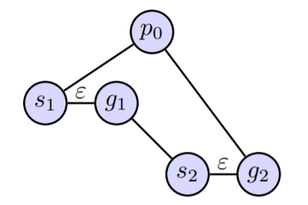
Hardness proof: Reduction from E-TSP to TORO-NO

Slide 9
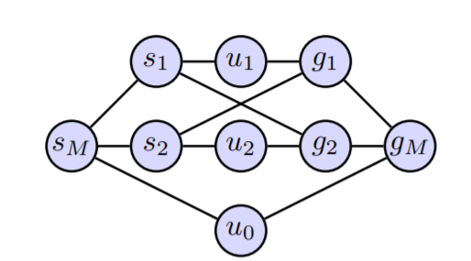
Solution: Reduction from TORO-NO to TSP
Weight is 0
Weight is the corresponding distance

Slide 10
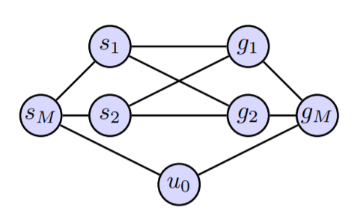
Bonus: Reduction from TORO-UNO to TSP

Slide 11
TORO (with overlaps)

Slide 12
TORO
More important to minimize number of grasps than distance!
Let’s try to build a “dependency graph”

Slide 13
Dependency graph
2
3
3
1
2
4
1
2
4
4
3
1

Slide 14
Dependency graph
2
3
3
1
1
2
4
2
4
4
3
1

Slide 15
TORO
The number of extra pick-ups we’ll have to make is equal the the minimum amount of nodes we’ll have to move aside to “break” all dependency loops.
Sounds familiar?

Slide 16
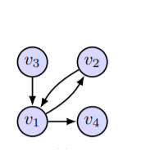
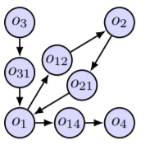
Hardness proof: Reduction from FVS to TORO
Fun fact: If the number of in-going and out-going edges for each vertex is bounded by 1, this problem is trivial (it’s just a bunch of cycles), but if it’s bounded by 2 it’s already NP-Hard.
APX-Hard, to be exact!

Slide 17
Solution: Reduction from TORO to FVS

Slide 18
Solution: Reduction from TORO to FVS
Solving FVS:
The paper looked at two exact solvers that are based on Linear Programming
“ILP-Constraint”
“ILP-Enumerate”
As well as three Heuristic-based solvers:
Maximal Simple Cycle Heuristic (MSCH) – keep picking the vertex that’s on the most number of cycles
Maximum Cycle Heuristic (MCH) – Similar, but counts cycles differently
Maximum Degree Heuristic (MDH) – Looks at the vertices with the highest degrees.
Once FVS found, minimizing the travel distance is done using more Linear Programming
To gain optimal solution one may iterate over all FVSs and find the one that results in the best minimal travel distance
But the practical benefits aren’t that great…

Slide 19
Performance Evaluation

Slide 20
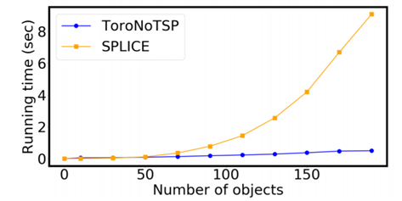
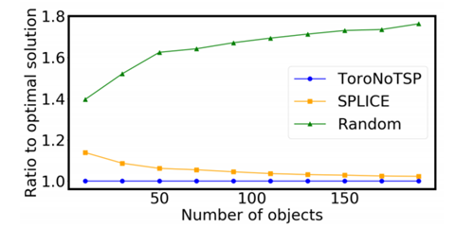
TORO-NO-TSP (and TORO-UNO-TSP)

Slide 21
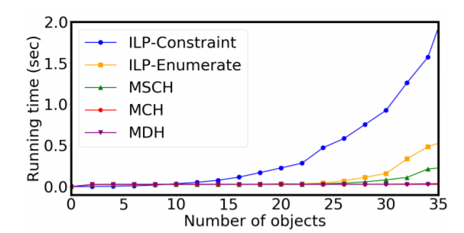
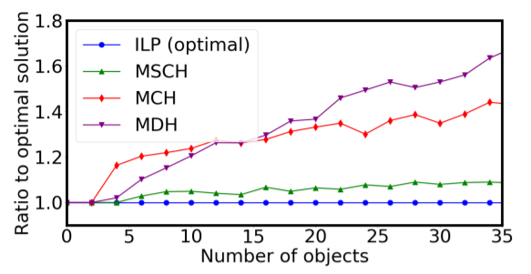
TORO Solvers

Slide 22
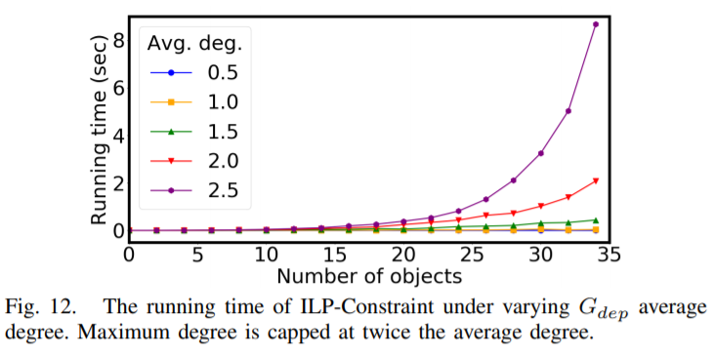
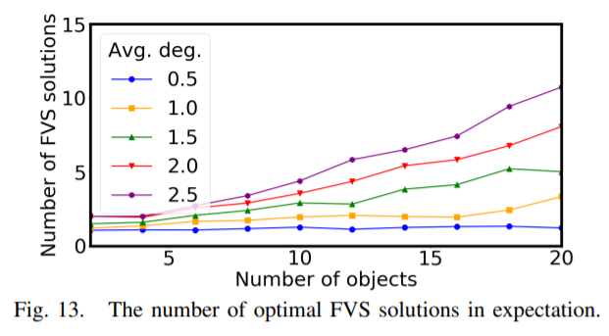
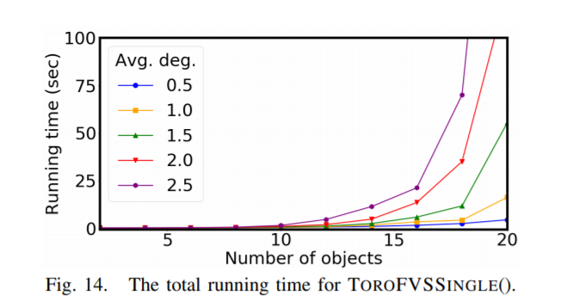
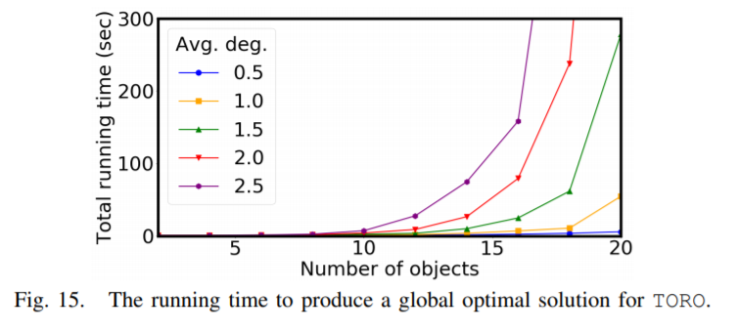
TORO Solvers – Cont.

Slide 23
Where do we go now?
Denser and more entangled TORO cases where there’s limited “buffer” space.
They didn’t really think any further

