Slide 1
Rotations in Space with Quaternions
18.11.19
Tom Verbin
Algorithmic Robotics and Motion Planning
Notes:
This presentation was made for the course “Algorithmic Robotics and Motion Planning” (0368-4010) in Tel Aviv University, instructed by Prof. Dan Halperin

Slide 2
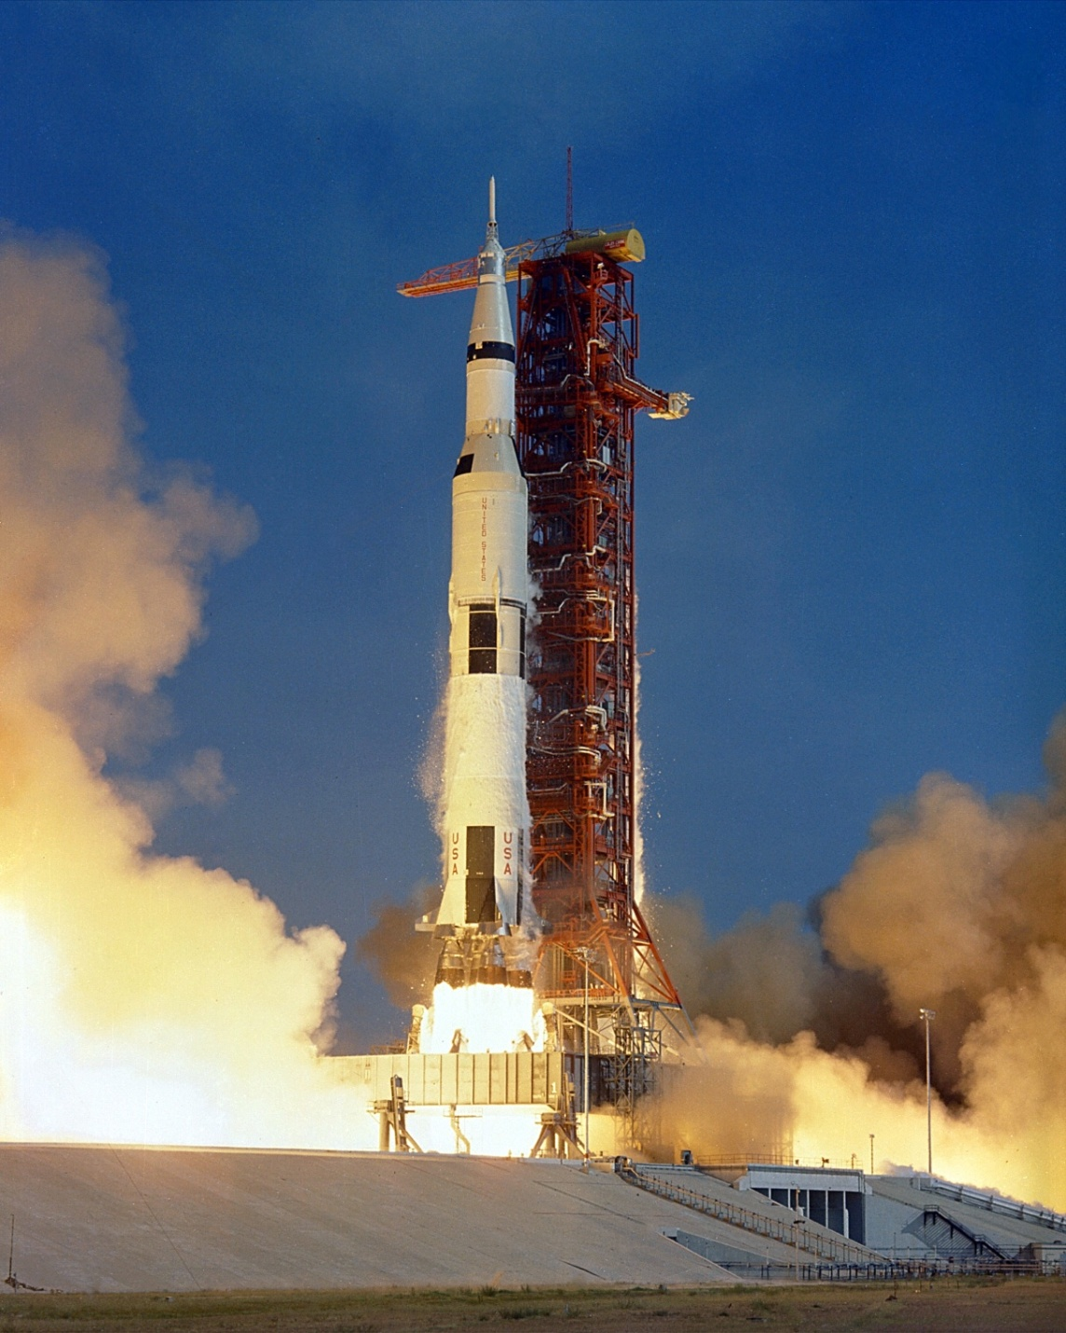
Let’s start with space…

Slide 3
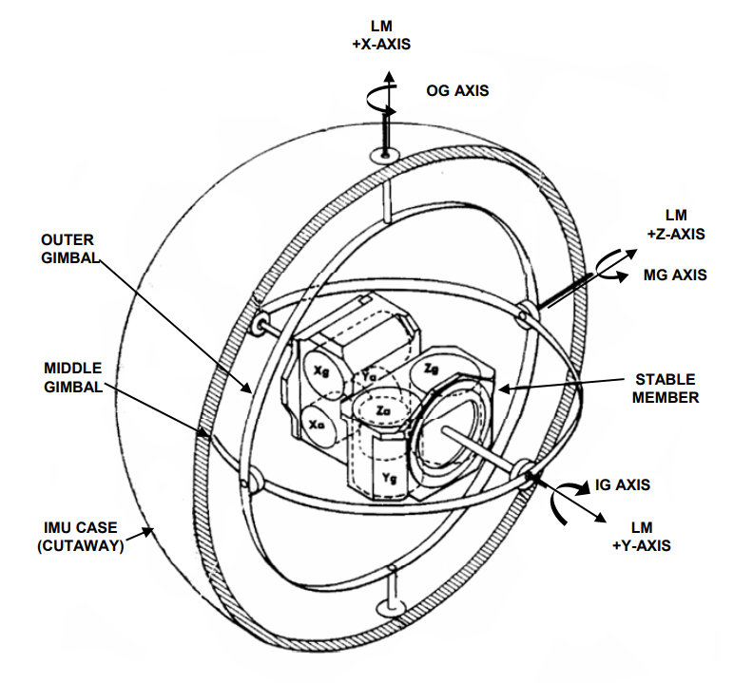
Apollo 11 IMU

Slide 4
Euler angles

Slide 5
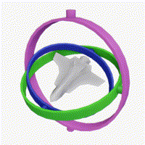
Gimbal Lock

Slide 6
Space
Rotation
Quaternions

Slide 7
Quaternions

Slide 8
Quaternions definition
For a, b, c, d ∈ ℝ :
q=a+bi+cj+dk
i²=j²=k²=-1
ijk=-1

Slide 9
Quaternions – basic op. (1/3)
Addition – simple:
(a+bi+cj+dk)+(e+fi+gj+hk)
=
(a+e)+(b+f)i+(c+g)j+(d+h)k
e.g. (3+2j)+(i-5j-4k)=3+i-3j-4k

Slide 10
Quaternions – basic op. (2/3)
Multiplication:
e.g.:
(1+2k) × (i+j+k) = i+j+k+2j-2i-2 = -2-i+3j+k
× | 1 | i | j | k
1 | 1 | i | j | k
i | i | -1 | k | -j
j | j | -k | -1 | i
k | k | j | -i | -1

Slide 11
Quaternions – basic op. (3/3)
Conjugate:
Norm:
Relation between them:

Slide 12
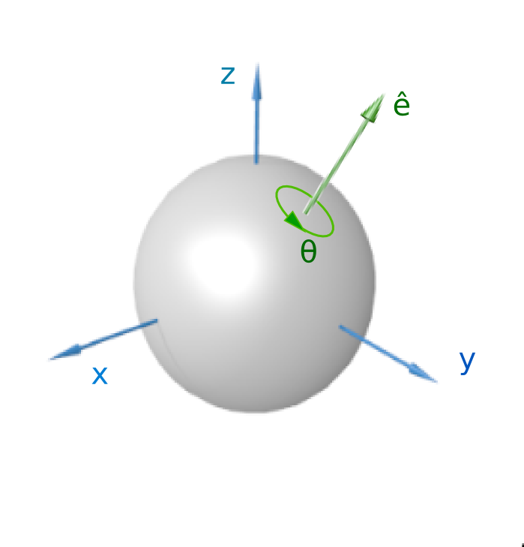
Euler's rotation theorem

Slide 13
Rotation with Quaternions
We define:
Note:

Slide 14
What is it good for?
To rotate (x,y,z) around (0,0,0) with quaternion:
The inverse a rotation is

Slide 15
What is it good for? (Cont.)
Two rotations can be described by multiplication of quaternions
Continues “optimal” rotation:

Slide 16
Where can you find rotation quaternions?
Graphics
Physics
Motion planning

Slide 17
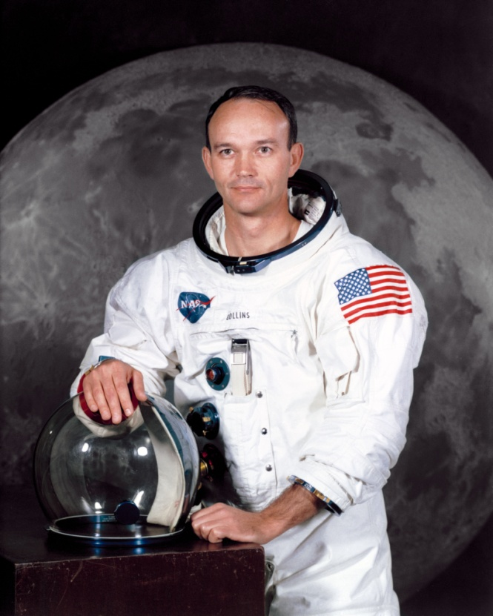
“How about sending me a fourth gimbal for Christmas.” – Michael Collins, Apollo 11, 2 hours after the Moon landing

Slide 18
Questions?

